Slide 1

















Building Positive Classroom Cultures
THE FOUNDATIONS OF POSITIVE BEHAVIOUR
Session 1

Slide 2

THE FOUNDATIONS OF POSITIVE BEHAVIOUR
Positive behaviour doesn’t begin with sanctions.
It begins with culture.

Slide 3
By the end of this Spark…
We will explore:
  What sits underneath positive behaviour
  Why relationships, routines and expectations matter
  The role adults play in shaping classroom culture
  One small change we can make this week

Slide 4
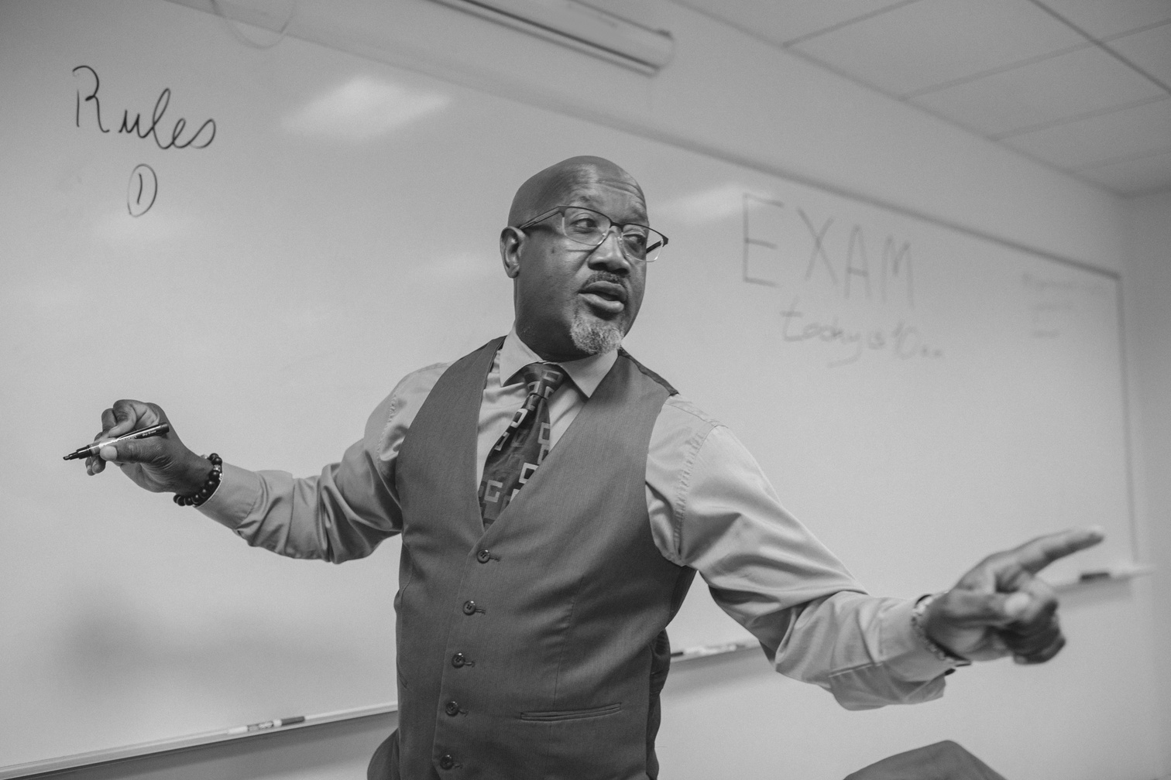

SAFEGUARDING SPARK
Safeguarding is everyone’s responsibility
A pupil who is usually punctual, engaged and well-presented begins arriving late, appears tired and becomes increasingly withdrawn.
Remember: We don’t need to know why something has changed before sharing a concern.
What might you notice?
What would you record?
Who would you speak to?

Slide 5
BEHAVIOUR DOESN’T HAPPEN IN ISOLATION
What we see:
Calling out • Refusal • Disruption • Withdrawal • Conflict
What may sit underneath:
Relationships • Belonging • Regulation • Previous experiences • Unmet need • Classroom environment • Expectations
Behaviour matters — but understanding the context helps us respond effectively.

Slide 6
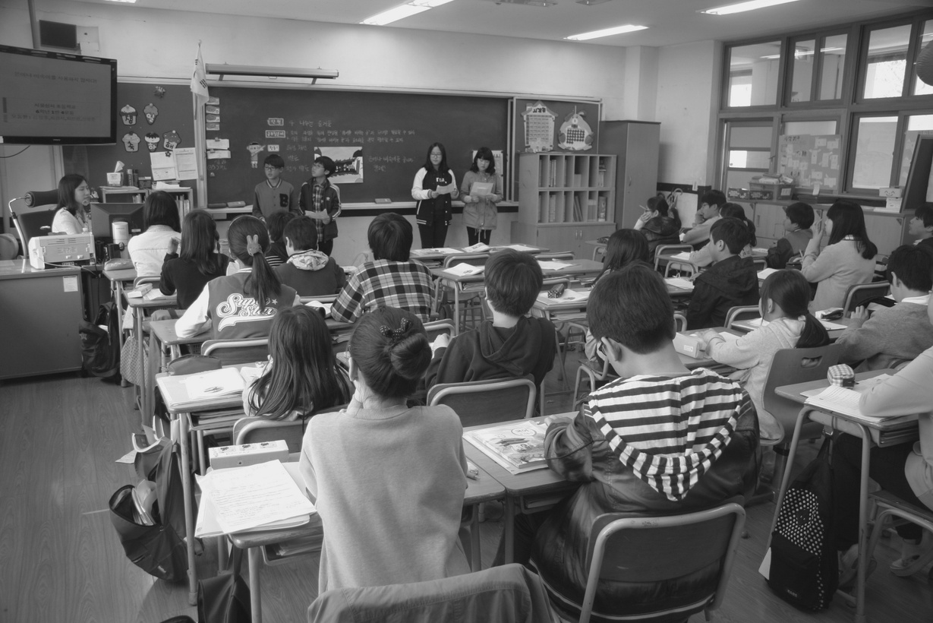
CULTURE COMES BEFORE CORRECTION
Pupils need to know:
What is expected
What it looks and sounds like
That adults will respond consistently
That mistakes can be repaired
That they still belong when things go wrong
Strong behaviour cultures are built deliberately.
Positive behaviour is something we teach, model and reinforce.

Slide 7

THE ADULT SETS THE WEATHER
Our behaviour influences theirs.
Calm → Calm
Predictable → Safe
Consistent → Trusting
Respectful → Connected
Paul Dix emphasises the importance of adults managing their own responses before attempting to change those of children.
The behaviour we model becomes part of the culture we create.

Slide 8

A relational approach does not mean lowering expectations.
Effective classrooms combine:
Warmth + Boundaries
“I care about you.”
AND
“I will hold you to this expectation.”
Restorative practice is not about avoiding consequences.
It is about maintaining dignity, accountability and relationships when things go wrong.
CONNECTION AND BOUNDARIES

Slide 9

TEACH THE BEHAVIOUR YOU WANT TO SEE
We explicitly teach phonics.
We explicitly teach mathematics.
We explicitly teach writing.
So why would we assume pupils automatically know how to:
  Enter a classroom
  Listen to another person
  Transition between activities
  Ask for help
  Manage disagreement
  Recover after making a mistake?
Behaviour can be taught, practised and strengthened.

Slide 10

CONSISTENCY CREATES SAFETY
Pupils should not have to work out:
“Which version of the adult am I getting today?”
Predictability reduces uncertainty.
That means:
  Clear expectations
  Calm responses
  Reliable routines
  Consistent language
  Follow-through
Consistency does not mean every child always receives an identical response.
It means our values and expectations remain dependable.

Slide 11

CATCH THE CULTURE YOU WANT
What adults notice becomes important.
Instead of only responding when behaviour goes wrong, deliberately notice when pupils:
  Show kindness
  Meet expectations
  Recover from difficulty
  Make a better choice
  Help someone else
  Demonstrate self-control
Be specific: “I noticed you were frustrated, but you stopped and tried again.”
We are reinforcing the behaviour and the identity behind it.

Slide 12
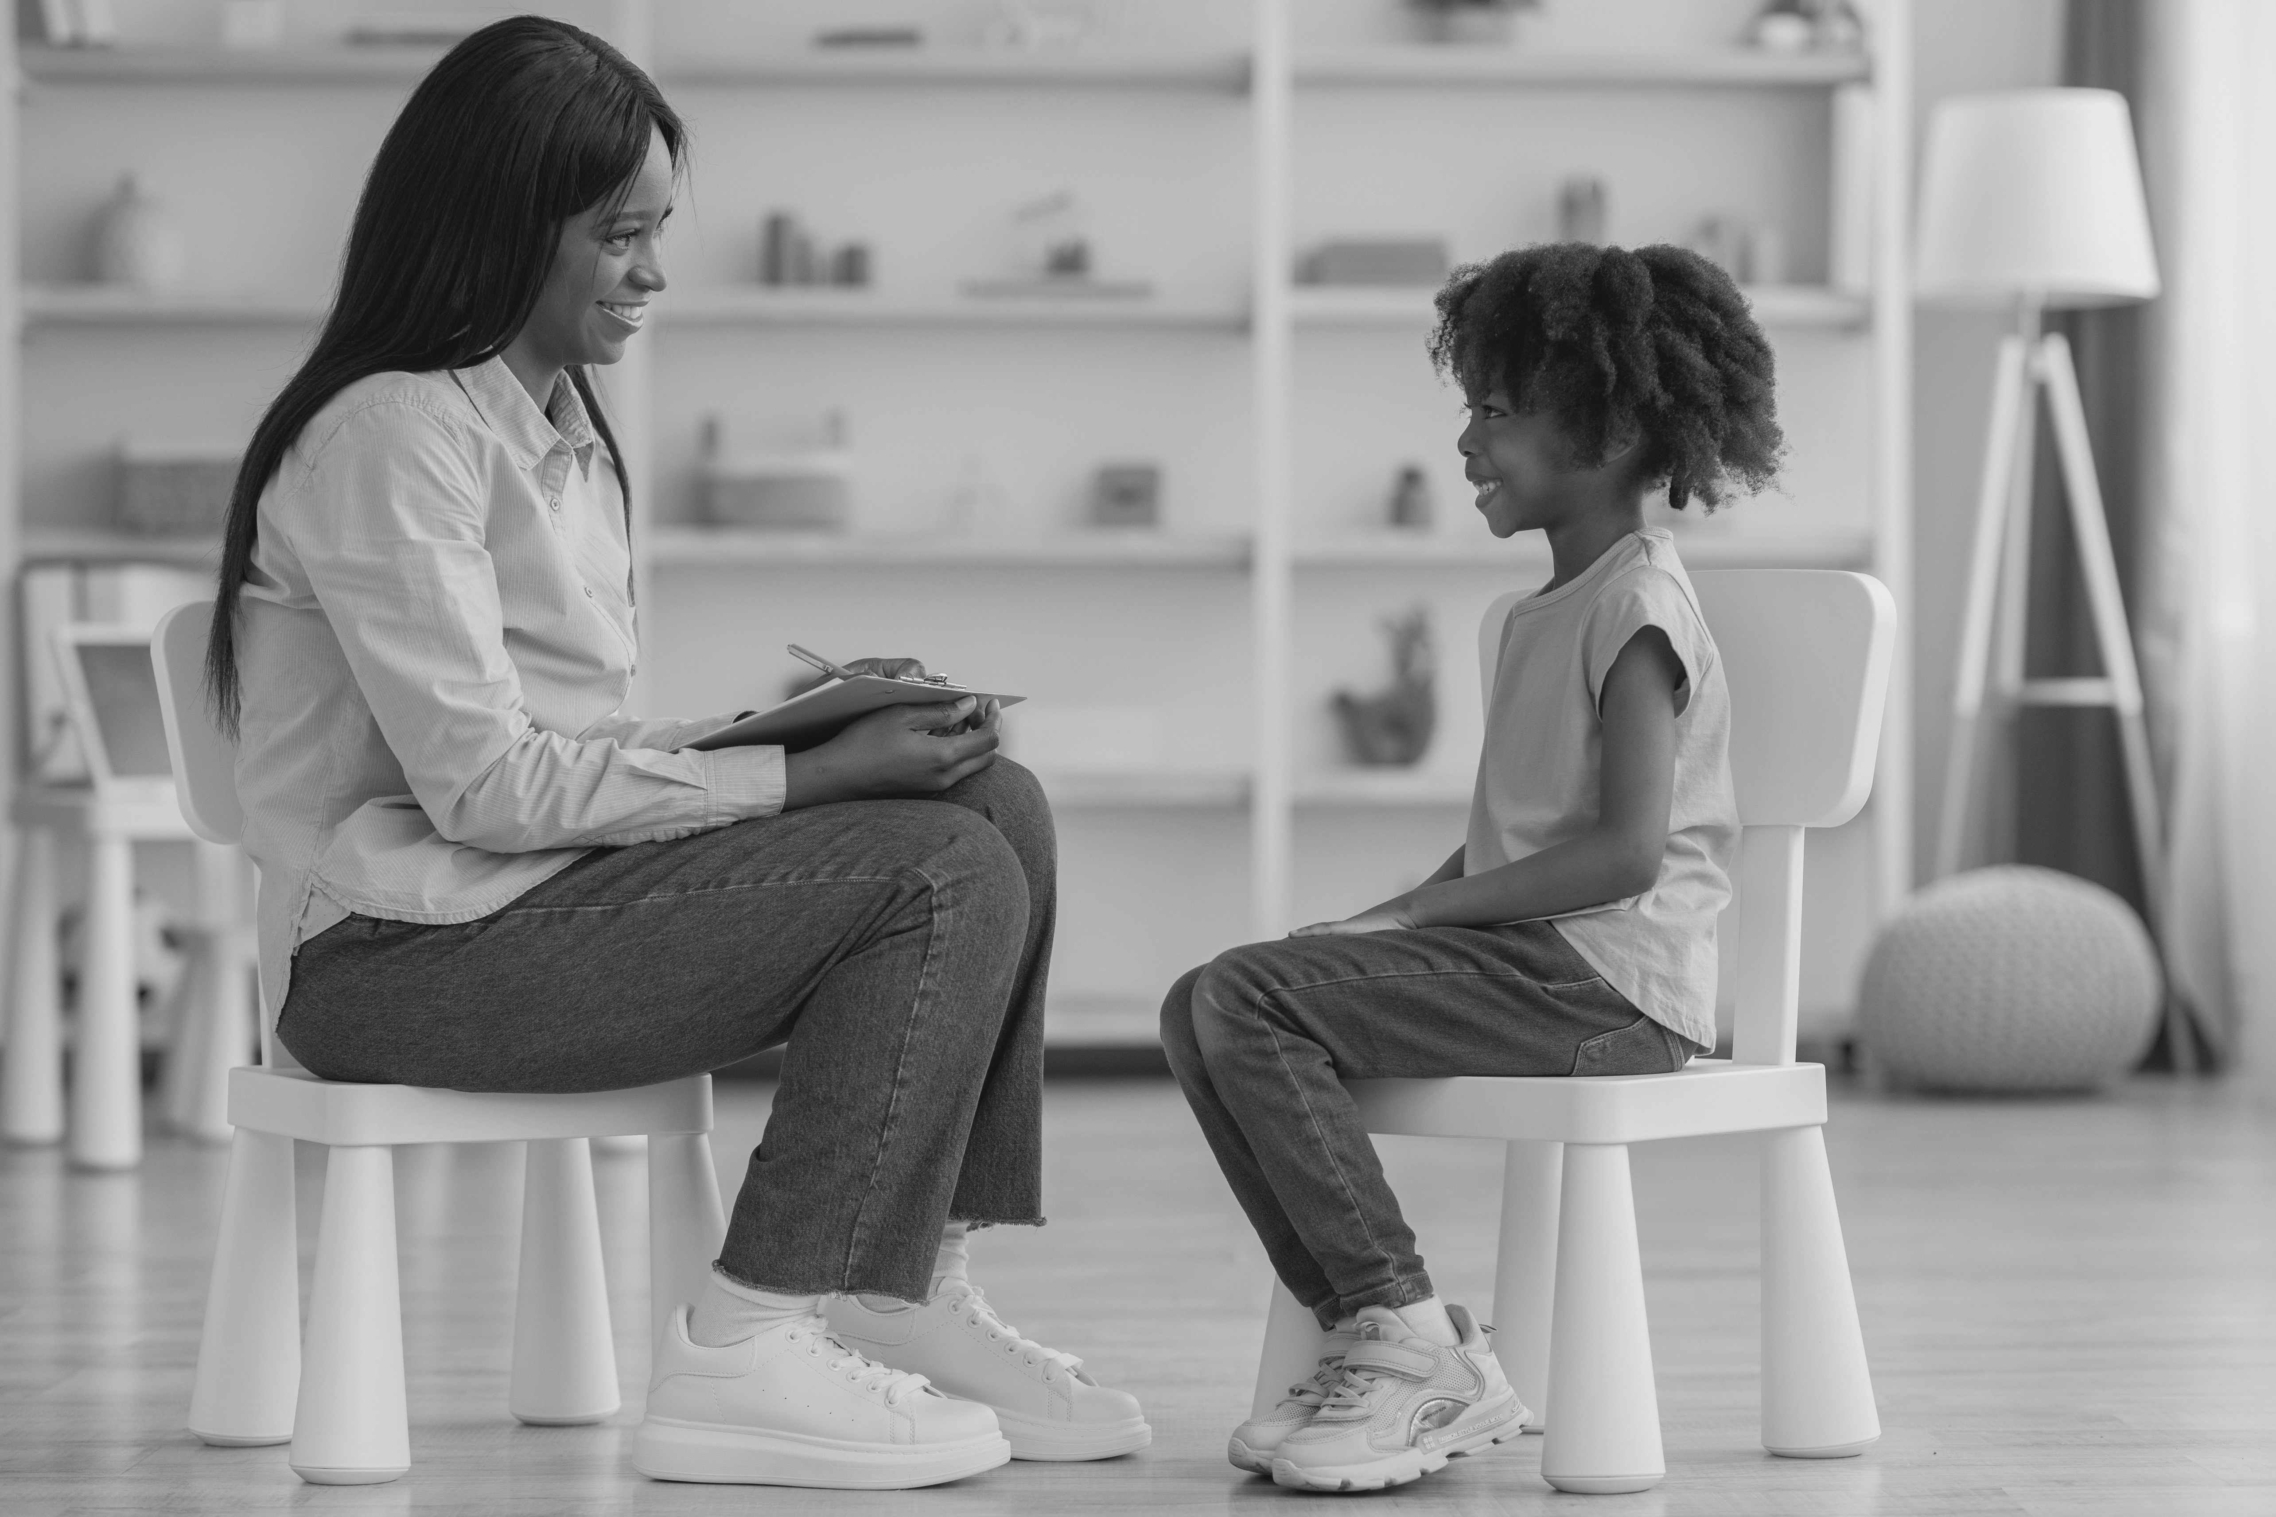
A RESTORATIVE LENS
When something goes wrong, move beyond: “What punishment does this deserve?”
Towards:
What happened?
Who has been affected?
What needs to happen now?
How can we repair this?
What will help this pupil succeed next time?
Accountability remains — but the goal is repair and learning, not simply compliance.

Slide 13
REFLECTION
Think about your classroom…
If a visitor spent one morning in your room, what would pupils' behaviour tell them about your classroom culture?
Would they see:
Safety?
Belonging?
Respect?
Predictability?
High expectations?
Warm relationships?
Which is currently strongest?
Which needs strengthening?

Slide 14
SPARK FORWARD
One small tweak this week
Choose one behaviour you regularly correct.
Instead of waiting to correct it:
Teach it.
Model it.
Practise it.
Notice it.
Reinforce it.
Next week, reflect:
Did explicitly teaching the behaviour reduce the need to correct it?

Slide 15
FINAL THOUGHT
Culture is built in the small interactions that happen every day.
Every greeting.
Every correction.
Every boundary.
Every repair.
Small interactions, repeated consistently, become classroom culture.

Slide 16
EVIDENCE & FURTHER READING
Paul Dix — When the Adults Change, Everything Changes
Adult consistency, relationships and calm behaviour practice.
Tom Bennett — Creating a Culture: How School Leaders Can Optimise Behaviour. Independent review of behaviour and culture in schools.
Education Endowment Foundation — Improving Behaviour in Schools
Evidence-informed recommendations including relationships, classroom management and targeted approaches.
Department for Education — Behaviour in Schools
National guidance on behaviour cultures, expectations and responses.

