Slide 1





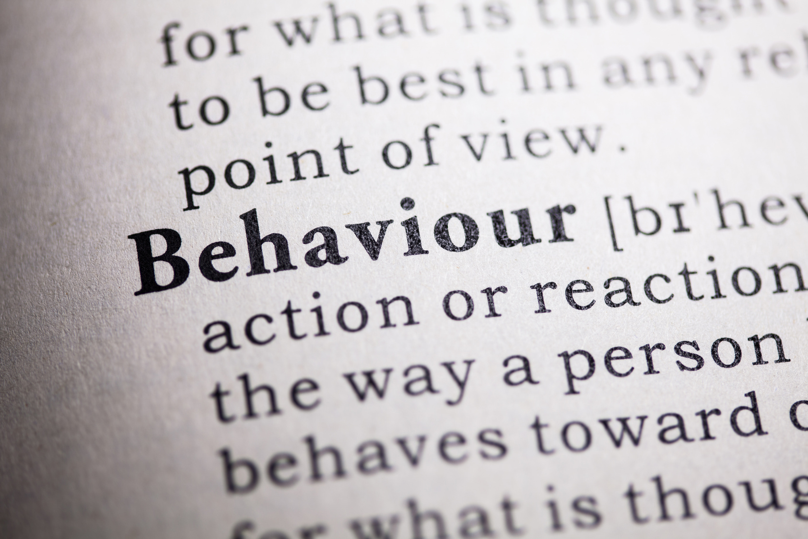

Restorative Practice in Schools
What restorative practice really means
Session 1

Slide 2

Safeguarding Spark
“Don't tell them I told you.”
A pupil tells you something concerning about what happens at home, then immediately says:
“But don't tell anyone. Promise?”
Consider:
What should you say?
What shouldn't you promise?
Who needs to know?
Remember: Never promise confidentiality. Listen carefully, reassure appropriately, record the pupil's words accurately and follow your school's safeguarding procedures.

Slide 3

Success Criteria
By the end of this spark, we will explore::
  What restorative practice actually means
  What it is — and what it isn't
  The difference between punishment and repair
  Why relationships and accountability work together
  One small restorative change to try this week

Slide 4
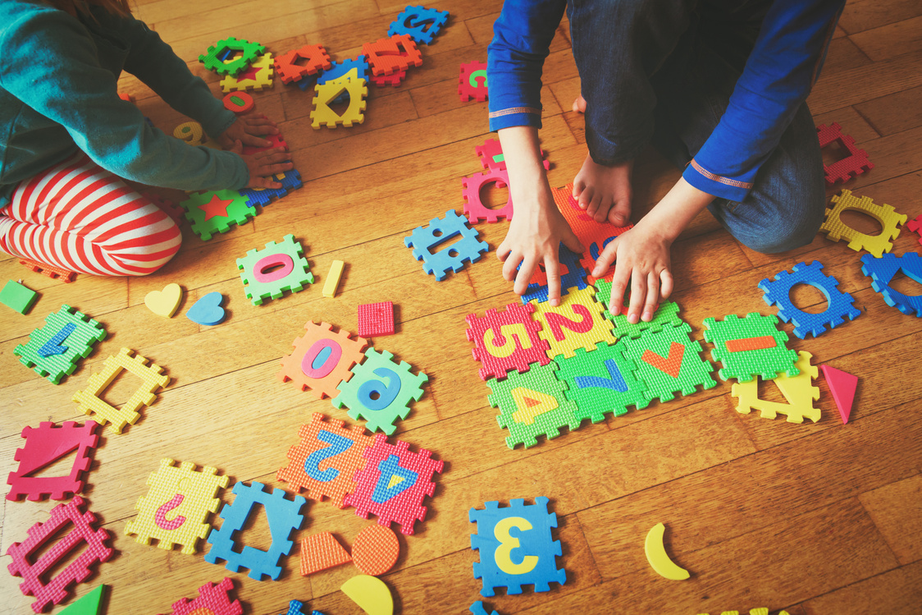

Our Journey
Week 1 - What restorative practice really means
Week 2 - Restorative conversations that work
Week 3 - Repairing relationships after conflict
Week 4 - Helping pupils take responsibility
Week 5 - Restoring classroom communities
Week 6 - Embedding restorative culture

Slide 5

What Does “Restorative” Mean?
At its simplest, restorative practice asks:
What happened?
Who has been affected?
What needs to happen to put things right?
What can we learn for next time?
The focus shifts from simply:
“What rule was broken?” towards also asking:
“What harm occurred — and how can it be repaired?”

Slide 6

Restorative Practice Is Bigger Than a Conversation
Restorative practice is sometimes reduced to a conversation after something goes wrong.
But a restorative culture is also built before incidents happen.
It includes:
Strong relationships
Clear expectations
Respectful communication
Belonging
Listening
Responsibility
Repair
Restorative practice is not just how we respond to conflict. It's how
we build community.

Slide 7
What Restorative Practice Is NOT
Restorative practice does not mean:
❌ No consequences
❌ Lower expectations
❌ Ignoring poor behaviour
❌ Forcing pupils to apologise
❌ Endless conversations
❌ Excusing behaviour because we understand it
❌ Expecting harmed pupils to immediately forgive
Restorative does not mean permissive.

Slide 8
Accountability Still Matters
A restorative response might sound like:
“What happened wasn't acceptable.”
AND
“Let's understand what happened.”
AND
“Someone has been affected by your actions.”
AND
“What needs to happen now?”
High expectations AND relationships
Boundaries AND dignity
Accountability AND repair
We don't have to choose between them.

Slide 9
Punishment or Accountability?
Imagine a pupil deliberately damages another pupil's work.
A purely punitive response might focus on:
“What consequence should they receive?”
A restorative response also asks:
“Who has been affected?”
“What responsibility does the pupil need to take?”
“How could the harm be repaired?”
A consequence may still be appropriate.
Restorative practice adds repair — it doesn't automatically remove consequences.

Slide 10

Behaviour Affects People
When behaviour goes wrong, we can become focused on:
The rule
The sanction
The behaviour point
The missed break
But behaviour happens within relationships and communities.
Ask:
Who was affected?
How were they affected?
What has changed because of what happened?
Restorative practice helps pupils see beyond the rule to the impact of their actions.

Slide 11

From Blame to Responsibility
Compare: “Why did you do that?”
with: “What happened?”
Compare: “You knew better.”
with: “Who has been affected by what happened?”
Compare: “Say sorry.”
with: “What could you do to help put this right?”
The aim isn't to remove responsibility.
It's to help pupils take responsibility.

Slide 12

The Restorative Questions
Useful restorative questions might include:
What happened?
What were you thinking or feeling at the time?
What have you thought since?
Who has been affected?
How have they been affected?
What needs to happen now?
What could help next time?
Questions create reflection — but only when pupils are ready to engage with them.

Slide 13
Timing Matters
Immediately after an incident, a pupil may be:
Angry
Upset
Embarrassed
Overwhelmed
Defensive
That may not be the best moment for a detailed restorative conversation.
Sometimes the first response is simply:
CALM → SAFETY → SPACE
Then later:
REFLECT → REPAIR → RECONNECT
Restorative conversations work best when people are ready to participate.

Slide 14
An Apology Is Not the Same as Repair
We often finish behaviour incidents with:
“Now say sorry.”
But a forced apology can become:
“Sorry.”
…and nothing changes.
Repair might instead involve:
Acknowledging the impact
Replacing something damaged
Putting something right
Changing future behaviour
Rebuilding trust
Offering a genuine apology when ready
Repair should mean more than saying the word “sorry”.

Slide 15
The Person Harmed Matters Too
Restorative practice should never become entirely focused on the pupil who caused harm.
The person affected may need:
To be listened to
Their experience acknowledged
Reassurance
Safety restored
A voice in what happens next
They should not be pressured to:
Accept an apology
Forgive
Meet face-to-face
“Move on” before they are ready
Repair must never create further harm.

Slide 16
Separate the Behaviour From the Child
Restorative language allows us to say:
“What you did wasn't acceptable.”
without communicating:
“You are unacceptable.”
We can challenge behaviour while preserving dignity.
The behaviour needs addressing.
The harm needs repairing.
The relationship can continue.
A pupil can get something wrong without becoming the wrongdoer forever.

Slide 17
Restorative Practice Is Proactive Too
Don't wait for conflict.
Build restorative habits through everyday interactions:
Listen before assuming
Use pupils' names
Model respectful disagreement
Give pupils a voice
Notice positive contribution
Teach how to repair mistakes
Create opportunities for belonging
The strongest restorative conversations sit within already-restorative relationships.

Slide 18

Reflection
THINK ABOUT YOUR PRACTICE…
Think about a recent behaviour incident.
Ask:
What happened?
Who was affected?
What consequence followed?
Was the impact explored?
Was there an opportunity for repair?
Did the pupil know how to move forward afterwards?
Then consider:
“Did we simply deal with the behaviour — or did we help repair what happened?”

Slide 19
Spark Forward
ONE SMALL TWEAK THIS WEEK
After one appropriate behaviour incident, add one restorative question to your usual response.
Try: “Who has been affected by what happened?”
or:
“What needs to happen to put this right?”
Don't change your whole behaviour system.
Don't remove existing boundaries.
Simply add repair to the conversation.
At the end of the week, reflect:
“Did the question change the quality of the conversation?”

Slide 20
Restorative practice is not about making behaviour expectations softer.
It's about making accountability deeper.
We still:
Challenge.
Hold boundaries.
Protect others.
Use consequences where appropriate.
But we also:
Listen.
Understand impact.
Take responsibility.
Repair.
Reconnect.
Don't just ask: “What consequence is needed?”
Also ask: “What needs to be repaired?”

Slide 21


References & Links
DfE – SEND Code of Practice: 0–25 Years
EEF — Improving Behaviour in Schools
Restorative Justice Council

