Slide 1

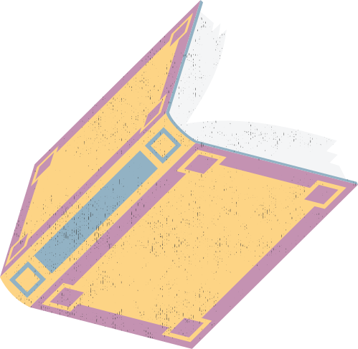




High-Quality Interactions & Scaffolding Learning
What is scaffolding and why it works
SESSION 1

Slide 2
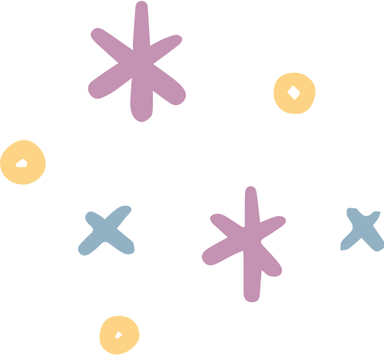
safeguarding spark
What is radicalisation?
  a
  b
  c
  d
The process by which a person adopts extreme views or ideologies that may lead to harmful actions
A disagreement between people with different opinions that leads to an argument.
The process of encouraging a child to become more independent and confident.
A school behaviour policy used to manage challenging behaviour.

Slide 3

safeguarding spark
What is radicalisation?
  a
  b
  c
  d
The process by which a person adopts extreme views or ideologies that may lead to harmful actions
A disagreement between people with different opinions that leads to an argument.
The process of encouraging a child to become more independent and confident.
A school behaviour policy used to manage challenging behaviour.

Slide 4



the journey ahead
  1
What is scaffolding and why it works
  2
Using prompts instead of telling
  3
Effective questioning techniques for TAs
  4
Encouraging independence and resilience
  5
Giving feedback without giving answers
  6
Recognising when to step back

Slide 5
What Is Scaffolding?
Scaffolding is temporary support that helps a pupil access learning they cannot yet manage independently.
Think of scaffolding around a building: it provides support while something is being constructed, but it is not designed to remain forever.
Learning scaffolds work in the same way.
SUPPORT → SUCCESS → REDUCE → INDEPENDENCE
The goal isn't permanent support. The goal is growing independence.

Slide 6


Why Does Scaffolding Work?
Scaffolding allows pupils to access challenge without removing it.
Connect learning
Help pupils link new learning to knowledge and strategies they already have.
Access challenge
Provide support while maintaining ambitious expectations.
Experience success
Give enough support for pupils to succeed while still doing meaningful thinking themselves.
Build independence
Gradually reduce support as pupils become increasingly confident and capable.

Slide 7
What Can a Scaffold Look Like?
Scaffolding isn't always an adult sitting beside a pupil.
🗣 A verbal prompt
👀 A visual
📝 A model
🧩 A structure
🗣 A verbal prompt - A short reminder that nudges thinking without providing the answer.
👀 A visual - A word bank, number line, diagram, checklist or vocabulary prompt.
📝 A model - An example or worked example that helps pupils understand what successful learning looks like.
🧩 A structure - A sentence stem, writing frame or sequence of steps that makes a complex task more manageable.

Slide 8

Scaffolding or Doing?
SCAFFOLDING
"What do you already know?"
"What could help you?"
"Where could you look?"
"What could you try first?"
DOING THE THINKING
"I'll show you."
"Write this."
"Do this next."
"The answer is…"
Ask yourself: Who is doing most of the thinking — the adult or the pupil?

Slide 9
Finding the Right Level of Support
Too little support
Pupils may become frustrated, stuck or disengaged.
Just enough support
Pupils experience challenge, think for themselves and achieve success.
Too much support
Pupils can become reliant on adult help and have fewer opportunities to problem-solve independently.
🎯 The aim:
Enough support for success — enough space for thinking.

Slide 10
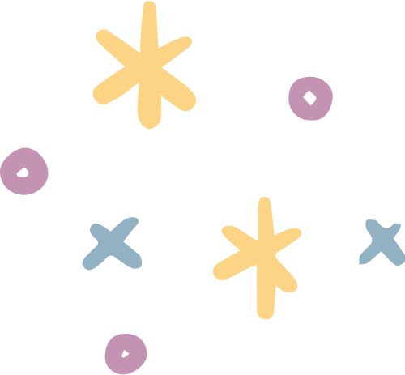
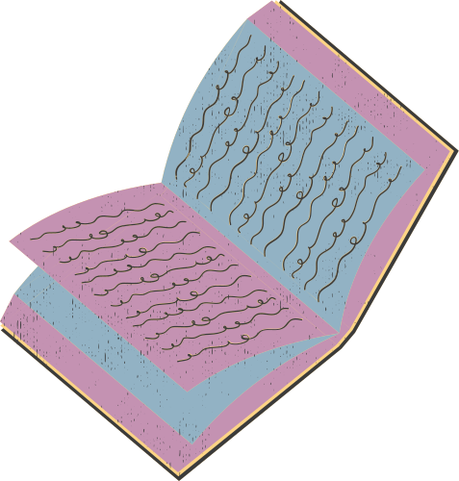
Temporary Means Temporary
A scaffold should change as the pupil's confidence and competence grow.
Initially…
Adult model + support
↓
Then…
Prompt + resource
↓
Later…
Small reminder
↓
Eventually…
Independent pupil
A scaffold that is never reduced can unintentionally become a dependency.

Slide 11
what does successful scaffolding look like?
Don't only ask: "Did they finish the task?"
Instead, notice whether pupils are beginning to:
START tasks with less reassurance.
SELECT useful resources independently.
TRY strategies before asking for help.
CHECK and correct their own work.
PERSEVERE when something feels difficult.
Independence is the real measure of success.

Slide 12
Common Pitfalls
⚠️ Stepping in too quickly
A pupil's pause does not necessarily mean they need help. Give thinking and processing time.
⚠️ Focusing on finished work
A completed worksheet with significant adult input may tell us very little about what the pupil can actually do.
⚠️ Becoming the pupil's permanent support
Constant adult proximity can unintentionally reduce opportunities to interact with the teacher, peers and learning resources.
⚠️ Leaving scaffolds in place
Regularly ask whether the pupil still needs the same level of support.

Slide 13

⚡ Spark Forward
Choose one pupil you regularly support.
Before stepping in:
PAUSE → WATCH → DECIDE
PAUSE - Give the pupil time to think.
WATCH - Notice what they attempt independently.
DECIDE - What is the smallest amount of support they need to move forward?
This week's challenge: Notice what happens when you give slightly less help.

Slide 14
Final Reflection
Before you leave, consider...
1. Do I sometimes step in before a pupil has had enough time to think?
2. Who does most of the thinking during my interactions with pupils?
3. Are there pupils who may have become reliant on my support?
4. Which scaffolds could I begin to reduce?
Complete this sentence: "One change I will make to my support this week is..."

Slide 15


evidence
Education Endowment Foundation - Making Best Use of Teaching Assistants
Guidance on using TA support to develop independent learning rather than creating over-reliance.
EEF – Making Best Use of Teaching Assistants
Education Endowment Foundation
Special Educational Needs in Mainstream Schools
Evidence-informed recommendations around high-quality teaching, scaffolding and supporting pupils with SEND.
EEF – Special Educational Needs in Mainstream Schools
Education Endowment Foundation - Metacognition and Self-Regulated Learning
Useful evidence around developing pupils who can increasingly plan, monitor and manage their own learning.
EEF – Metacognition and Self-Regulated Learning

Slide 16




The best scaffold is one we can eventually remove.

