Slide 1


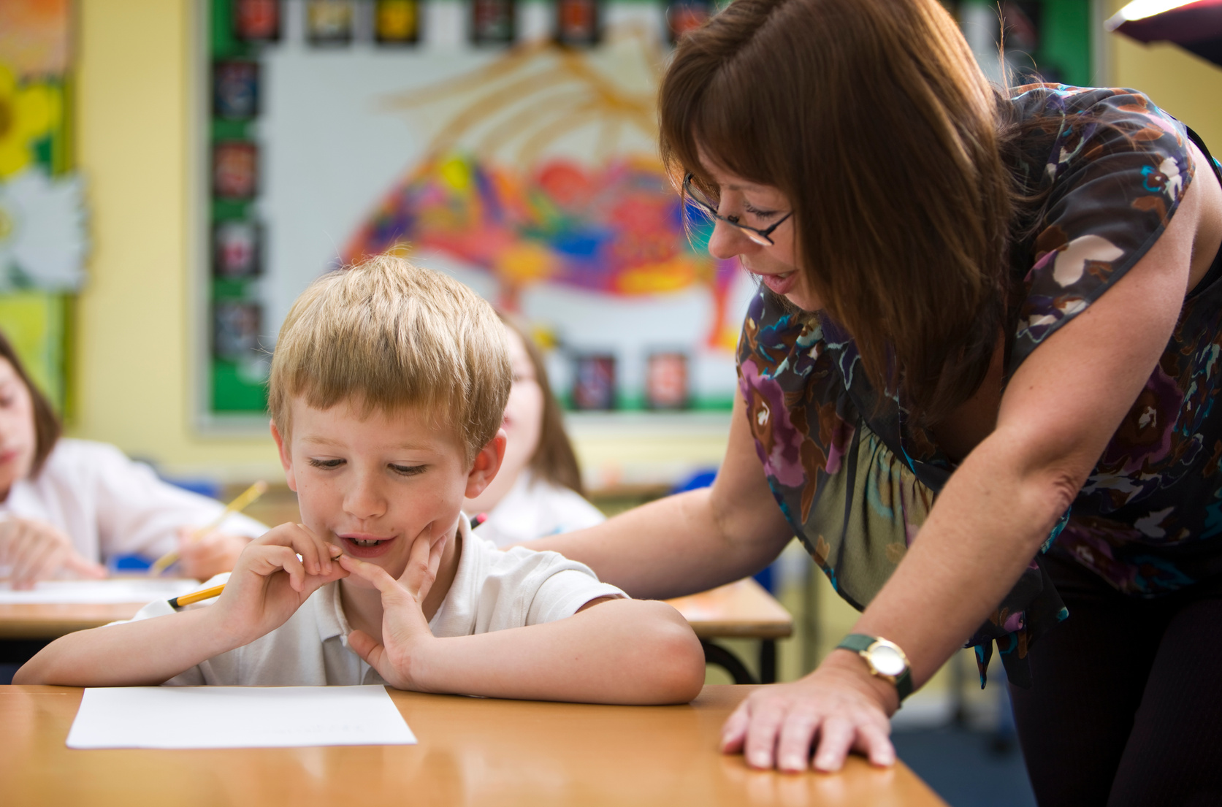




EYFS Sparks
Creating Exceptional Learning Environments
What Makes an Outstanding EYFS Environment?
Session 1

Slide 2


Safeguarding
During a routine walk around the learning environment, you notice a secluded area that cannot be seen clearly by staff. What should you do?
A. Leave it as it is because the children enjoy using it.
B. Mention it at the next staff meeting.
C. Review the area immediately, ensure children can be supervised effectively and report any concerns in line with your setting's safeguarding procedures.
D. Close the area without discussing it with colleagues.

Slide 3

Safeguarding
During a routine walk around the learning environment, you notice a secluded area that cannot be seen clearly by staff. What should you do?
A. Leave it as it is because the children enjoy using it.
B. Mention it at the next staff meeting.
C. Review the area immediately, ensure children can be supervised effectively and report any concerns in line with your setting's safeguarding procedures.
D. Close the area without discussing it with colleagues.

Slide 4

Success Criteria
By the end of this session, you will:
✓ Understand the key features of an exceptional EYFS learning environment.
✓ Reflect on how the environment influences children's behaviour, independence and learning.
✓ Identify practical improvements that make the greatest difference to children's daily experiences.

Slide 5
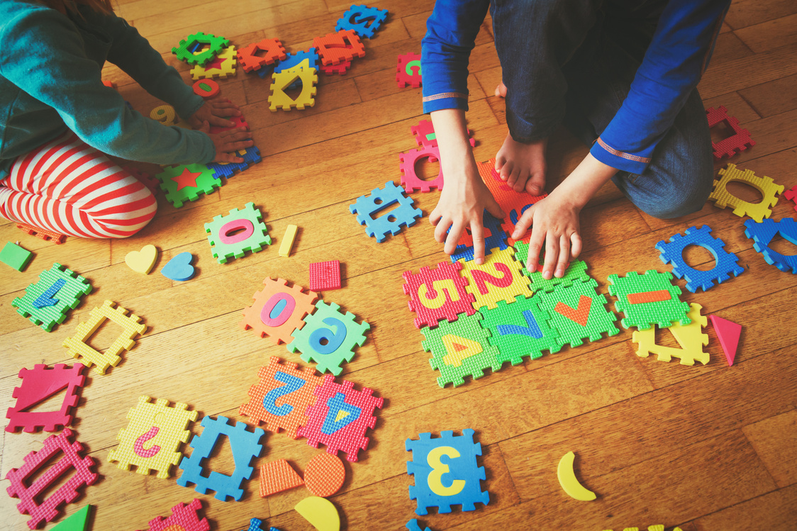
Our Journey
Week 1 - What Makes an Outstanding EYFS Environment?
Week 2 - Enabling Environments Indoors
Week 3 - Outdoor Learning with Purpose
Week 4 - Using Resources to Promote Independence
Week 5 - Supporting Self-Regulation Through Environment
Week 6 - Continuous Improvement Through Environment Audits

Slide 6

Why This Matters
Children's learning is shaped by the spaces they spend time in.
A well-designed indoor environment allows children to:
✔ Make independent choices.
✔ Sustain play for longer.
✔ Solve problems.
✔ Return to previous learning.
✔ Access resources confidently.
The classroom should support learning - even when adults are not directing it.

Slide 7

What Does the Research Say?
Research highlights that effective indoor environments:
  reduce cognitive overload
  promote independence
  encourage sustained shared thinking
  support executive functioning
  strengthen communication and language
  allow children to revisit and deepen learning.
The physical environment influences behaviour just as much as adult interactions.

Slide 8
Everything Has a Purpose
Ask yourself:
Does every area of my classroom have a clear learning purpose?
Every space should answer one question:
"What learning is this area designed to promote?"
If we cannot answer that question...
Perhaps the area needs redesigning.

Slide 9
Accessibility Creates Independence
Children should be able to:
🧺 Find resources.
🧩 Return resources.
✂️ Select tools.
📚 Choose books.
🎨 Access creative materials.
Without constantly asking an adult.
When children manage their own environment...
They become more confident learners.

Slide 10
Quality Over Quantity
Busy classrooms can become overwhelming.
Outstanding indoor environments are not filled with resources.
They are filled with purposeful resources.
Ask:
  Do children use this?
  Does it inspire thinking?
  Does it promote creativity?
  Is it open-ended?
Sometimes removing resources improves learning.
Less can truly be more.

Slide 11
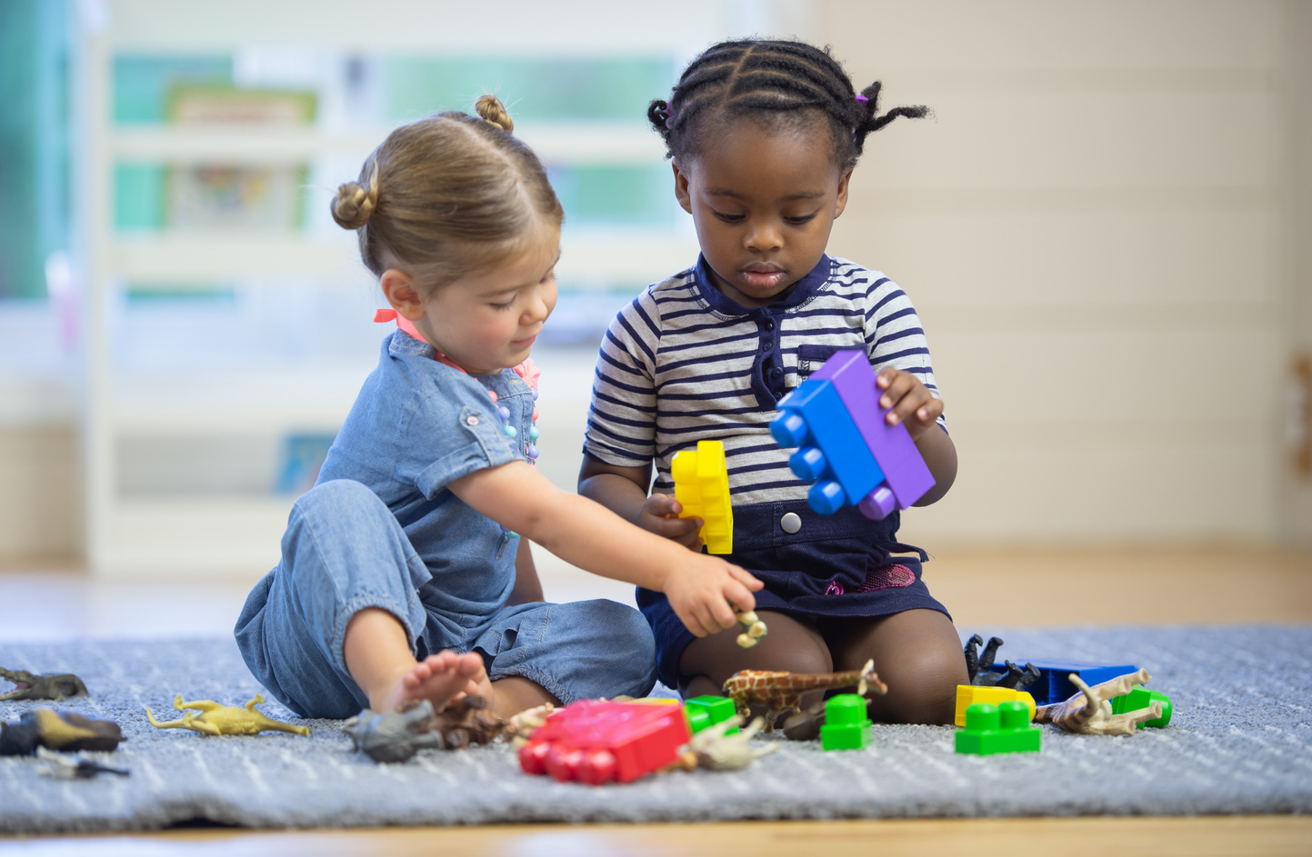
The Power of Continuous Provision
Children revisit familiar areas because they feel confident there.
Instead of constantly changing provision...
Keep core areas consistent.
Enhance them thoughtfully.
For example:
Construction + photographs of bridges
Role play + real-life artefacts
Creative area + natural materials
One small enhancement can completely transform children's thinking.

Slide 12

Enabling Environments in Action
After reflection:
✔ Front-facing books.
✔ Story props.
✔ Puppets.
✔ Family photographs.
✔ Comfortable lighting.
✔ Story recommendation cards.
Book Corner
Originally:
  Shelves of books.
  Cushions.
Children begin:
📖 Reading together.
🗣 Retelling stories.
🎭 Acting out characters.
💬 Discussing books independently.
The environment encourages interaction - not simply storage.

Slide 13
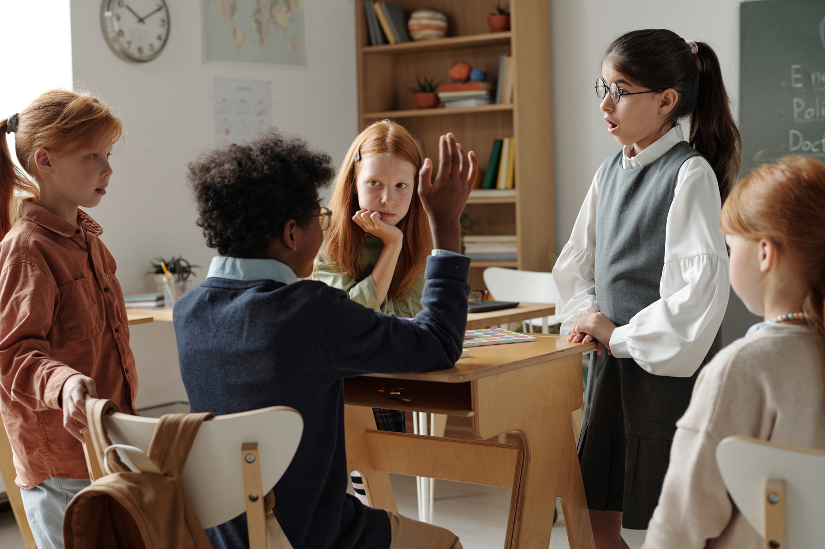
Watch It in Action
Walk around your classroom and ask:
  Can children use every area independently?
  Which spaces encourage the richest conversations?
  Where do children remain engaged the longest?
  Which resources are rarely touched?
  What could be simplified?
Suggested viewing:
  Early Excellence – Enabling Environments
  Birth to 5 Matters
  Curiosity Approach classroom tours
  Early Years Stronger Practice Hubs

Slide 14

Reflection Activity
Indoor Environment Audit
Working with colleagues, choose one area of your classroom.
Discuss:
  What learning is promoted here?
  Can children access everything independently?
  Which resources are most valuable?
  Which resources are rarely used?
  What one change would improve this area?
Remember:
Outstanding classrooms evolve through continuous reflection - not complete redesigns.

Slide 15

Spark Forward
Choose one indoor learning area.
Observe how children use it for one day.
Then make one purposeful improvement.
It might be:
  removing unnecessary resources
  improving accessibility
  introducing one meaningful enhancement
  reorganising storage.
Observe what changes in children's play and independenc

Slide 16
An enabling indoor environment doesn't direct children where to go.
It invites them to explore.
To create.
To investigate.
To collaborate.
To return again and again because there is always something new to discover.
The best classrooms are not remembered because they looked impressive.
They are remembered because they helped children feel capable.
When the environment empowers children to become independent learners, it has achieved its greatest purpose.

Slide 17


References & Links
EYFS Statutory Framework
Early Education - Birth to 5 Matters
Education Endowment Foundation- Preparing for Literacy Guidance Report
Loris Malaguzzi - The Environment as the Third Teacher
The Reggio Emilia approach highlights the environment as an active partner in children's learning, encouraging exploration, relationships and independence.
Julie Fisher - Starting from the Child
Explores how environments should be designed around children's developmental needs, interests and independence.
Elizabeth Jarman - Communication Friendly Spaces
Research into how thoughtfully designed physical environments support communication, wellbeing and learning.

