Slide 1

UNDERSTANDING BEHAVIOUR
BEHAVIOUR AS COMMUNICATION
WEEK 1

Slide 2

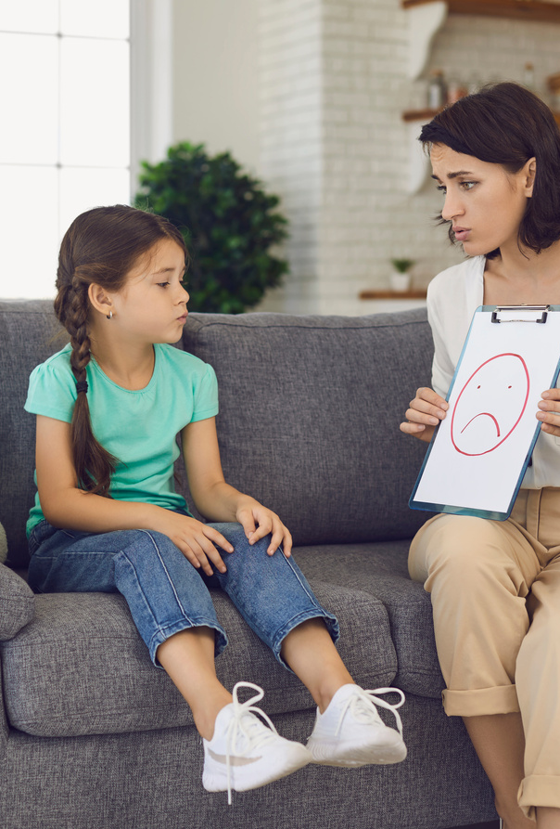




BEHAVIOUR AS COMMUNICATION
“Behaviour tells us something — even when pupils cannot tell us themselves.”

Slide 3
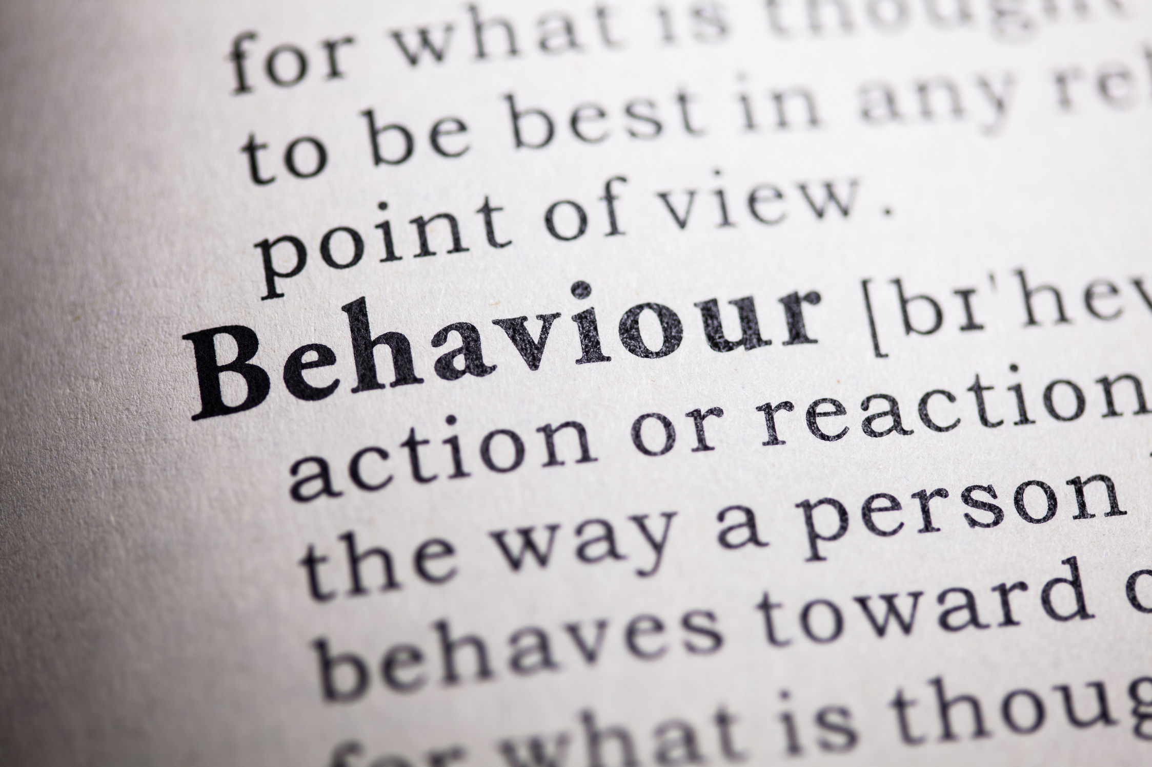
BY THE END OF THIS SPARK…
We will explore:
  What we mean by behaviour as communication
  Why the same behaviour can have different causes
  The difference between describing and interpreting behaviour
  How curiosity can improve our response
  One small change we can make this week

Slide 4





SAFEGUARDING SPARK
A sudden change
A pupil who is usually confident and sociable becomes:
Quiet.
Withdrawn.
Easily startled.
Reluctant to join friends.
There is no disclosure.
Consider:
What should you notice?
What should you record?
Who needs to know?
Remember: We do not need a disclosure before sharing a safeguarding concern. A significant change in behaviour can itself be important information.

Slide 5

BEHAVIOUR IS WHAT WE SEE
We might see:
Refusal
Calling out
Withdrawal
Aggression
Avoidance
Disruption
Shutting down
But these describe what happened.
They don't necessarily tell us:
Why it happened.
Behaviour is visible.
The reasons underneath it often aren't.

Slide 6
BEHAVIOUR CAN COMMUNICATE
Behaviour might communicate:
“I don't understand.”
“This feels too difficult.”
“I don't feel safe.”
“I need connection.”
“I'm overwhelmed.”
“I don't know how to do this yet.”
“I need some control.”
Or something completely different.
The behaviour is information — not the whole explanation.

Slide 7
SAME BEHAVIOUR. DIFFERENT MESSAGE.
Imagine three pupils refusing to begin a task.
PUPIL A - Doesn't understand the instructions.
PUPIL B - Is frightened of getting it wrong.
PUPIL C - Has arrived dysregulated after something happened at break.
Same visible behaviour:
“Refusal.”
Different possible reasons.
The same response may not work for all three.

Slide 8
DESCRIBE BEFORE YOU INTERPRET
Compare:
“He's being defiant.”
with:
“He pushed the worksheet away and said, ‘I'm not doing it.’”
Or:
“She's attention seeking.”
with:
“She called my name six times while I was supporting another pupil.”
The first is an interpretation.
The second is an observation.
Start with what you actually saw and heard.

Slide 9
REPLACE JUDGEMENT WITH CURIOSITY
Instead of: “Why are they doing this to me?”
Try: “What might be happening here?”
Instead of: “They know better.”
Try: “What is getting in the way right now?”
Instead of: “They're just attention seeking.”
Try: “What need might they be trying to meet?”
Curiosity opens up more possible responses.

Slide 10
LOOK FOR WHAT HAPPENED BEFORE
Behaviour rarely happens in a vacuum.
Ask:
What happened just before?
A difficult task?
A transition?
A change of adult?
Unstructured time?
A friendship difficulty?
A correction?
A sensory demand?
A perceived failure?
Patterns can help us understand what may be triggering or maintaining behaviour.

Slide 11
AND WHAT HAPPENS AFTERWARDS?
ALSO NOTICE WHAT HAPPENS AFTER THE BEHAVIOUR. | Does the pupil:
Escape the task? | Gain adult attention?
Receive peer attention? | Move to a quieter space?
Avoid something difficult? | Gain connection with an adult?
This isn't about assuming behaviour is deliberately manipulative. It's about understanding:
What does the behaviour achieve or change for the pupil?

Slide 12

BEHAVIOUR CAN BE COMMUNICATION WITHOUT BEING ACCEPTABLE
This distinction matters.
We can say:
“I want to understand why this happened.”
AND
“That behaviour isn't acceptable.”
We can be:
Curious AND boundaried.
Compassionate AND accountable.
Understanding AND consistent.
Understanding the behaviour helps us respond — it doesn't remove responsibility.

Slide 13
WHAT SKILL MIGHT BE MISSING?
Sometimes behaviour tells us a pupil can't yet do something consistently, rather than simply won't.
Perhaps they struggle to:
Ask for help | Tolerate frustration | Wait | Manage disappointment | Enter a group
 | Resolve conflict | Recover from mistakes | Regulate strong emotions
Ask: What might need teaching, not just correcting?

Slide 14
BE CAREFUL WITH THE STORY WE CREATE
Repeated behaviour can quickly become a pupil's identity.
 | “He's difficult.” | “She's an attention seeker.”
 | “He's lazy.” | “She's manipulative.”
These labels can influence what we notice next.
Instead: Describe the behaviour. Look for patterns. Stay curious.
The behaviour is something a pupil does — not who they are.

Slide 15
WHAT MIGHT WE BE MISSING?
When behaviour occurs, consider four questions:
WHAT? What exactly happened?
BEFORE? What happened immediately beforehand?
AFTER? What happened as a result?
NEED? What might the pupil have needed in that moment?
We may not immediately know the answer.
Curiosity is more useful than certainty.

Slide 16
REFLECTION
THINK ABOUT YOUR PRACTICE…
Think of a behaviour you regularly encounter.
Perhaps:
Calling out.
Refusal.
Conflict.
Avoidance.
Shutting down.
Now ask:
How have I interpreted this behaviour?
What evidence supports that interpretation?
What else might the behaviour be communicating?
Would a different understanding change my response?

Slide 17

SPARK FORWARD
ONE SMALL TWEAK THIS WEEK
  Choose one behaviour you regularly encounter.
  Before responding, mentally ask:
  “What might this behaviour be telling me?”
  Notice:
  What happened before.
  What the pupil did.
  What happened afterwards.
  Don't try to solve everything.
  Just become more curious about the pattern.
At the end of the week, reflect:
Did noticing the pattern change how I responded?

Slide 18
BEHAVIOUR IS THE PART WE CAN SEE.
UNDERNEATH MAY BE:
NEED.
EMOTION.
EXPERIENCE.
SKILL.
RELATIONSHIP.
ENVIRONMENT.
COMMUNICATION.
DON'T ONLY ASK, “HOW DO I STOP THIS?”
ALSO ASK, “WHAT MIGHT THIS BE TELLING ME?”

Slide 19
EVIDENCE & FURTHER READING
EDUCATION ENDOWMENT FOUNDATION — IMPROVING BEHAVIOUR IN SCHOOLS
HIGHLIGHTS THE IMPORTANCE OF KNOWING PUPILS WELL AND UNDERSTANDING INDIVIDUAL INFLUENCES ON BEHAVIOUR
EEF — IMPROVING BEHAVIOUR IN SCHOOLS
DEPARTMENT FOR EDUCATION — BEHAVIOUR IN SCHOOLS
NATIONAL GUIDANCE ON BEHAVIOUR EXPECTATIONS ALONGSIDE APPROPRIATE SUPPORT FOR PUPILS.
DFE — BEHAVIOUR IN SCHOOLS
PAUL DIX — WHEN THE ADULTS CHANGE, EVERYTHING CHANGES
RELATIONAL RESPONSES, ADULT BEHAVIOUR AND LOOKING BEYOND IMMEDIATE BEHAVIOUR.
TOM BENNETT — CREATING A CULTURE
CLEAR EXPECTATIONS, BEHAVIOUR CULTURE AND CONSISTENT ADULT RESPONSES.

