Slide 1


Creating an Inclusive Classroom Culture
WHAT DOES AN INCLUSIVE CLASSROOM REALLY LOOK LIKE?
SESSION 1

Slide 2

Safeguarding Spark
A pupil regularly asks to stay inside at breaktime and offers to help the teacher rather than going outside.
What might this behaviour be communicating, and what would you do next?

Slide 3
Safeguarding Spark
Avoid assuming the pupil simply prefers being indoors. Their behaviour could indicate friendship difficulties, bullying, anxiety, sensory overwhelm or another concern.
  Speak with the pupil sensitively and without leading questions.
  Notice whether there are patterns or changes in behaviour.
  Share relevant concerns following your school's safeguarding procedures.
  Consider what support might help the pupil feel safe and included during less structured times.
Remember: Small changes in behaviour can sometimes tell us something important.

Slide 4

The Journey
Week 1 – What does an inclusive classroom really look like?
Week 2 – High expectations for every learner
Week 3 – Removing barriers before they appear
Week 4 – Belonging, relationships and participation
Week 5 – Universal strategies that benefit everyone
Week 6 – Reflecting on your own inclusive practice
Our aim: To move from thinking about inclusion as additional support towards seeing it as part of everyday classroom practice.

Slide 5
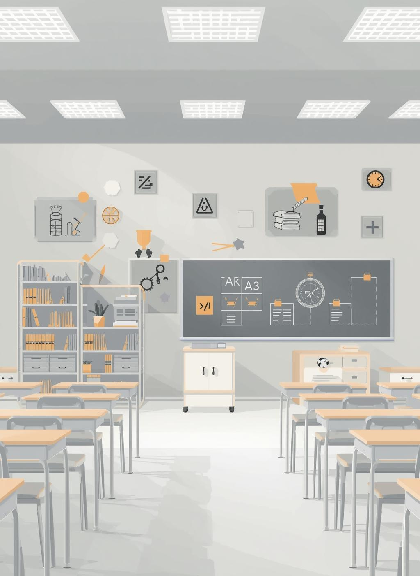
By the End of This Spark...
You will be able to:
  Explain what we mean by an inclusive classroom culture.
  Recognise the difference between presence, participation and belonging.
  Identify features of classroom practice that promote inclusion.
  Begin to notice potential barriers within your own classroom.
  Identify one small tweak that could strengthen inclusion this week.

Slide 6
Inclusion Is More Than Being in the Room
A pupil can be physically present in a classroom without being genuinely included.
Consider three questions:
Presence - Is the pupil learning alongside their peers?
Participation - Can they meaningfully access and contribute to the learning?
Belonging - Do they feel valued as a genuine member of the class?
Discuss: Can you think of a pupil who is present but may not always be fully participating?

Slide 7
What Might an Inclusive Classroom Look Like?
In an inclusive classroom:
  Difference is expected rather than treated as an exception.
  All pupils experience ambitious teaching.
  Support enables participation rather than creating separation.
  Pupils know that mistakes are part of learning.
  Classroom routines are predictable and accessible.
  Pupils see themselves represented and valued.
  Adults notice and remove barriers to participation.
  Independence is developed rather than support becoming permanent.
Inclusion is woven through everyday practice – not added afterwards.

Slide 8
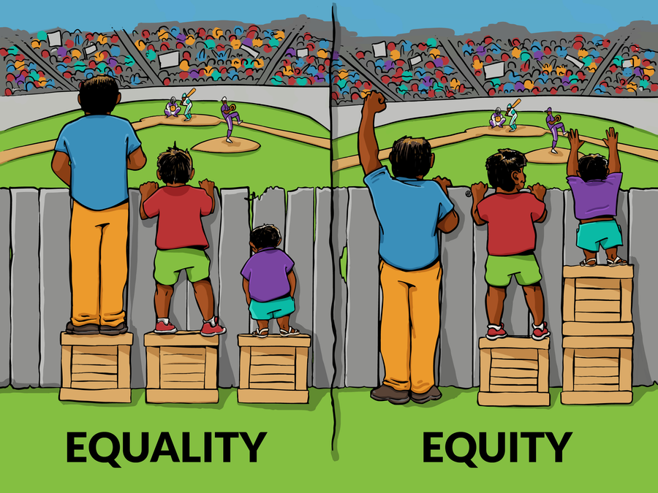
Equality or Equity?
Equality: Everyone receives the same thing.
Equity: Everyone receives what they need to access the same opportunities.
Giving every pupil exactly the same support can sometimes create barriers rather than remove them.
Example: Every pupil is expected to independently copy a learning objective from the board. It appears equal – but what barriers might this create? Consider pupils with:
  Dyslexia
  Visual difficulties
  Fine-motor difficulties
  Attention difficulties
  Slower processing
Inclusive practice asks: What is the purpose of this task, and does every pupil need to access it in exactly the same way?

Slide 9

START WITH THE ENVIRONMENT, NOT THE CHILD
When a pupil struggles, our first question can easily become:
"What is wrong?"
Inclusive practice encourages a different starting point:
"What might be getting in the way?"
Barriers might exist within:
  Instructions Vocabulary
  Classroom routines Sensory demands
  Resources Task design
  Relationships Expectations
  Physical environments Opportunities to participate
A powerful shift: From "Why can't this pupil do this?"
to "What could we change to make success more likely?"

Slide 10
Same Destination, Different Routes
Inclusion does not mean lowering expectations. Imagine the learning goal is:
"Explain how a character's feelings change throughout the story."
Different pupils might:
  Write independently
  Use sentence stems
  Discuss their thinking first
  Refer to a vocabulary bank
  Record their response
  Use symbols or visuals to organise ideas
  Receive targeted adult prompts
The learning remains ambitious. The route towards it can be flexible.
Discuss: When might providing exactly the same task actually make learning less inclusive?

Slide 11
The Language of Belonging
Small interactions repeatedly communicate:
"You belong here."
Or:
"This classroom wasn't really designed for you."
Consider the difference:
❌ "I've made an easier sheet for you."
✅ "I've given you something that will help you get started."
❌ "You won't be able to do this bit."
✅ "Let's think about what will help you access this."
❌ "My low group..."
✅ "This group is working with me today."
Our language shapes pupils' perceptions of themselves as learners.

Slide 12
Participation Matters
Ask yourself:
Who gets heard in my classroom? Think beyond pupils who willingly put their hands up.
Who regularly:
  Answers questions?
  Works with different peers?
  Takes leadership roles?
  Contributes to discussions?
  Represents the class?
  Receives positive recognition?
  Has their ideas built upon?
  Experiences success publicly?
An inclusive classroom does not simply offer opportunities. It notices who is - and isn't - accessing them

Slide 13
Inclusion Through a Pupil's Eyes
Imagine walking into your classroom as a pupil who finds learning difficult.
Would you know:
  What is happening?
  What you are expected to do?
  Where to find help?
  That making mistakes is safe?
  That adults believe you can succeed?
  That your contribution matters?
  That support is available without embarrassment?
  That you genuinely belong?
Reflection: Which of these would every pupil in your classroom confidently answer yes to?

Slide 14

Spark Forward
One Small Tweak This Week
Choose one pupil who may experience barriers to participation.
Don't begin by changing the pupil.
Instead, observe:
When do they participate most successfully?
When do they participate least?
What seems to change between those moments?
Then make one small adjustment to the environment, routine, instruction or resource.
Next week, reflect: Did my change make participation easier?
Small steps. Stronger practice.

Slide 15

Research & Evidence
EEF – Special Educational Needs in Mainstream Schools
EEF – Five-a-Day SEND Guidance
EEF – SEND Evidence Review
DfE – SEND Code of Practice

Slide 16
Inclusion is not a place, group or intervention.
It is the everyday experience we create for pupils.
Before your next lesson, ask yourself:
"Who might find it hardest to access, participate or feel successful in this lesson – and what can I change before they arrive?"
That small question can lead to a very different classroom.
Creating an inclusive culture isn't about making everything easier.
It's about making success possible.

