Slide 1





EYFS Sparks
What Makes an Interaction "High Quality"?
Session 1

Slide 2

Safeguarding Spark
How do you keep children safe on school trips?

Slide 3
Safeguarding Spark
By carrying out thorough risk assessments, maintaining appropriate supervision, following safeguarding procedures, and responding promptly to any concerns

Slide 4

By the end of today's session you will:
✓ Understand why adult interactions are the biggest influence on children's learning.
✓ Recognise the features of high-quality interactions.
✓ Reflect on your own everyday practice.

Slide 5


The Journey
Session 1 - What Makes an Interaction High Quality?
Session 2 - The Art of Questioning Young Children
Session 3 - Following Children's Interests
Session 4 - Language That Builds Thinking
5ession 5 - Knowing When Not to Intervene
Session 6 - Reflecting on Adult Practice
Today's focus: Understanding the foundations of exceptional interactions.

Slide 6
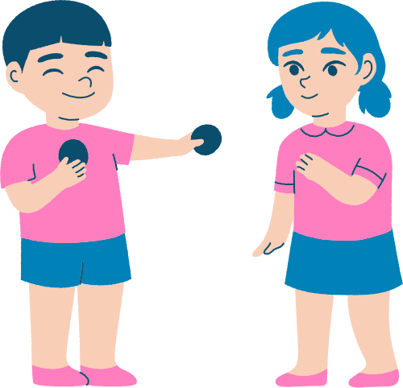
Why This Matters
Research consistently tells us:
The quality of adult-child interactions has a greater impact on children's learning than almost any resource or activity we provide.
Beautiful classrooms don't create learning.
Expensive resources don't create learning.
People create learning.
Every conversation...
Every smile...
Every question...
Every shared moment...
...helps build children's language, confidence and thinking.

Slide 7

What Does the Research Say?
The strongest Early Years settings have adults who:
• notice children's interests
• listen more than they talk
• extend children's thinking
• introduce new vocabulary naturally
• encourage children to solve problems
• build warm, trusting relationships
These everyday moments accumulate into powerful learning.

Slide 8

What Makes an Interaction High Quality?
Think about your own classroom.
High-quality interactions are:
❤️ Warm and responsive
👂 Based on careful listening
💬 Rich in conversation
🧠 Focused on extending thinking
🌱 Responsive to children's interests
⏳ Never rushed
Children should leave every interaction feeling:
"I was listened to." "I was valued." "I learned something."

Slide 9
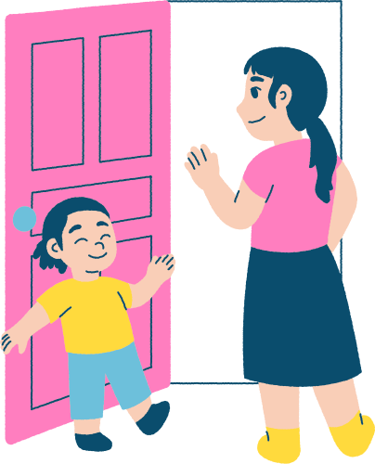
High Quality vs Low Quality
Lower Quality
Asking close questions
Gives answers quickly
DIrecting play
Talking most of the time
Correcting Immediately
Higher Quality
Encouraging thinking
Allowing children time
Joining play thoughtfully
Listening most of the time
Guiding children to discover

Slide 10
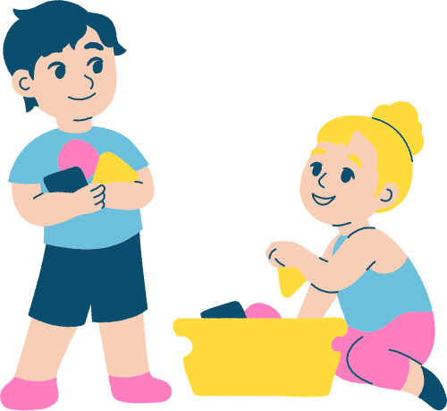
Sustained Shared Thinking
One phrase appears repeatedly throughout Early Years research:
Sustained Shared Thinking
This happens when:
An adult and child work together to solve a problem, clarify an idea, evaluate experiences or extend thinking.
It isn't about teaching.
It's about thinking with children.
Examples include:
"What do you think might happen if...?"
"I wonder why..."
"How could we find out?"

Slide 11
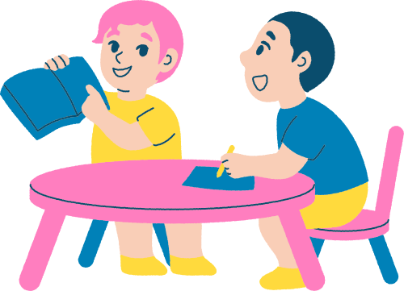
Everyday Opportunities
High-quality interactions happen everywhere.
✓ Snack time ✓ Outdoor play
✓ Story time ✓ Water play
✓ Construction ✓ Tidying up
✓ Dressing for outdoors ✓ Lunch
Learning doesn't only happen during planned activities.
The curriculum is woven through every conversation.

Slide 12
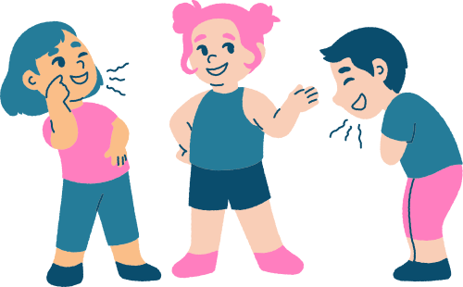
Reflection Activity
Interaction Audit
In pairs, discuss:
• Which interactions happen most often in our setting?
• When do we genuinely extend children's thinking?
• Where might we accidentally dominate conversations?
Then spend 10 minutes observing another adult.
Record:
  examples of excellent interactions
  examples where questions could be improved
  examples of sustained shared thinking
Share one takeaway with your team.

Slide 13
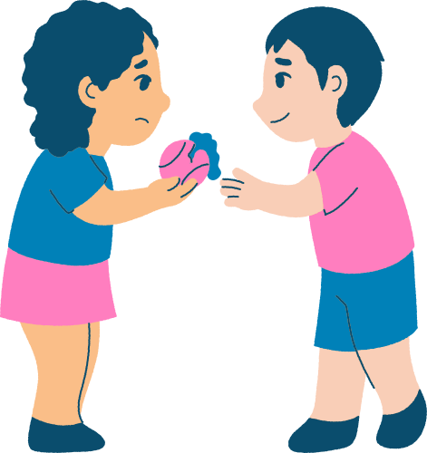
Reflection Challenge
This week, choose one child each day.
Spend five uninterrupted minutes following their interests.
Your goal is not to teach.
Your goal is to:
✓ Listen.
✓ Wonder.
✓ Extend.
✓ Encourage thinking.
Reflect at the end of the week:
What changed when I slowed down and truly listened?

Slide 14
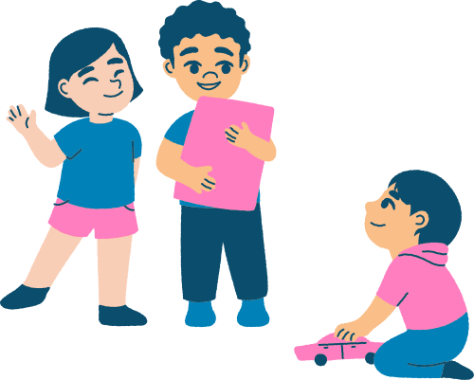
Closing Thoughts
Children rarely remember every activity we planned.
They remember how adults made them feel.
Exceptional Early Years practice isn't built through displays or resources.
It's built conversation by conversation.
Interaction by interaction.
Relationship by relationship.
When we improve our interactions, we improve every child's opportunity to learn.

Slide 15
Research Links
Education Endowment Foundation – Preparing for Literacy
Education Endowment Foundation – Communication and Language Approaches
Julie Fisher - interacting or interfering?
Julie Fisher - starting from the child
Department for Education – EYFS Statutory Framework

