Slide 1


Willingham’s Memory Model
Cognitive Science

Slide 2

Safeguarding Spark
What are the key elements of recording a safeguarding concern?

Slide 3
Safeguarding Spark
What are the key elements of recording a safeguarding concern?
Records must be Factual, Timely, Accurate, and Specific. Include the date/time, pupil’s words verbatim, your observations, and actions taken. Avoid assumptions or interpretations. Submit via the school’s agreed system and alert the DSL.

Slide 4

Implications for Teaching
Understanding cognitive principles allows educators to implement effective strategies that enhance student learning, minimize distractions, and foster a more engaging classroom environment. By grounding their practice in models like Willingham’s Simple Memory Model, teachers can design instruction that aligns with how the brain processes, stores, and retrieves information. This means intentionally directing students’ attention to the most important content, reducing cognitive overload by breaking information into manageable chunks, and using techniques like modelling, retrieval practice, and spaced repetition to strengthen long-term retention. When educators understand the limitations of working memory and the importance of rehearsal and retrieval, they can create learning experiences that are not only more effective but also more inclusive — supporting all learners in building secure, lasting knowledge.

Slide 5

What Is Memory?
Daniel Willingham's Simple Memory Model explains how information flows from the environment into working memory and long-term memory, emphasizing the importance of attention and retrieval in learning.
✅ Developed by Daniel Willingham
Cognitive scientist and professor of psychology at the University of Virginia.
Author of Why Don’t Students Like School? — a leading text in cognitive science for educators.
Willingham bridges the gap between research and classroom practice, focusing on how students think, learn, and remember.

Slide 6
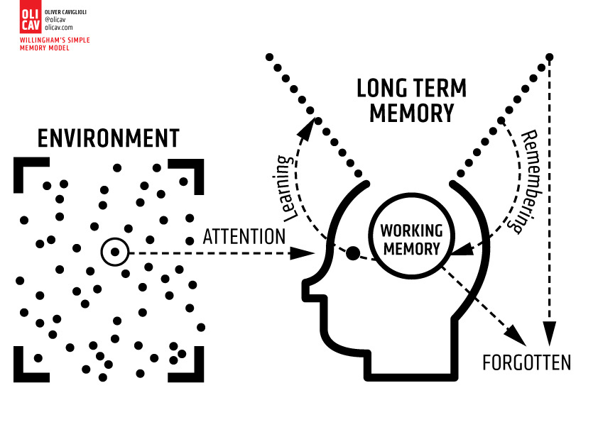
Daniel Willingham's Simple Memory Model explains how information flows from the environment into working memory and long-term memory, emphasizing the importance of attention and retrieval in learning.
🔄 The Model at a Glance
  This model offers a simplified explanation of how learning occurs by showing how information flows:
    From the environment
    Through attention
    Into working memory
    And, if processed effectively, into long-term memory

Slide 7
👁️‍🗨️ The Role of Attention
  Attention acts as a filter: from all the possible sensory input in the environment (sounds, visuals, text, distractions), only what we attend to enters working memory.
  This is why classroom displays, instructions, and visual aids must be clear, uncluttered, and purposeful.
  Teachers must direct student attention intentionally, using questioning, cues, gestures, or visual emphasis.
🧠 Working Memory – The Mental Workspace
  Working memory is where conscious thinking happens — it’s like a mental “whiteboard” where we hold and manipulate information.
  But it's limited: it can only hold a small amount of information at once (typically 3–5 items).
  If too much is introduced too fast, students may forget or misunderstand — this is known as cognitive overload.

Slide 8
🧬 Learning = Moving from Working Memory to Long-Term Memory
  Information that is rehearsed, connected to prior knowledge, or meaningfully understood can be encoded into long-term memory.
  Once stored, knowledge can be retrieved and applied in new situations.
  If information isn’t rehearsed or revisited, it is likely to be forgotten.
🔁 The Role of Retrieval
  Retrieval is remembering — pulling information from long-term memory back into working memory.
  Regular retrieval practice (quizzes, flashbacks, low-stakes tests)
  strengthens memory and makes knowledge more durable.
  Without opportunities to retrieve, students may appear to have learned something, but later forget it entirely.

Slide 9
🔍 Why This Model Matters for Teaching
  Highlights the importance of designing lessons around how memory actually works.
  Reminds teachers to:
    Avoid overloading students
    Use repetition and review
    Create connections between new and existing knowledge
    Make learning stick by planning for retrieval

Slide 10

Relevant Research
This section highlights foundational studies on memory and learning, emphasizing the significance of cognitive principles in education and their implications for effective teaching strategies.
1. Daniel Willingham – Why Don’t Students Like School?
  Clear explanations of memory, attention, and thinking
2. Sweller’s Cognitive Load Theory
  Reinforces limited capacity of working memory
3. Metacognition and self-regulation guidance
4. Dual Coding Theory – Paivio
  Explains benefits of combining verbal and visual content

Slide 11

What next?
How am I currently directing my students’ attention and how can I make it more intentional?
Think about distractions in your classroom environment and how you highlight key information.
Am I mindful of cognitive overload when introducing new material?
Consider how much new content you present at once — and whether students have time to process it.
What strategies am I using to help students transfer learning into long-term memory?
E.g., use of retrieval practice, repetition, dual coding, or elaboration.
How often do I build in opportunities for students to retrieve and apply previously learned content?
Reflect on whether your curriculum design supports spaced practice and regular review.
What small change can I make tomorrow to better align my teaching with how memory works?
Encourage an actionable takeaway — even something as small as rephrasing a question or reusing a key visual.

