Slide 1



















Communication, Oracy and Vocabulary
Why Oracy Starts in Nursery
Session 1

Slide 2
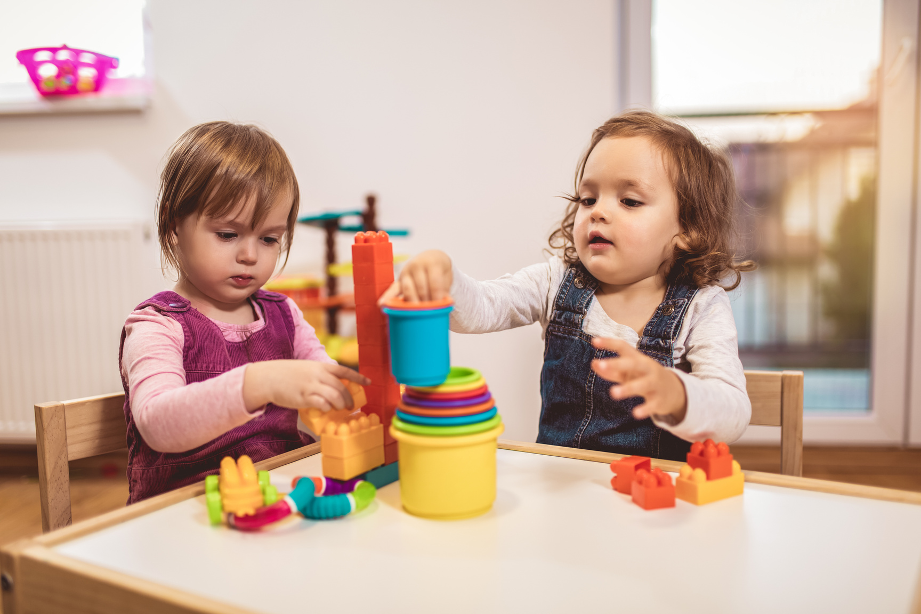
  SAfegarding spark
A child rarely speaks during nursery sessions but appears relaxed and chatty with their parent at collection.
What is the most appropriate response?
A. Observe the child's communication across different situations, discuss concerns with colleagues and parents where appropriate, and consider whether additional support may be needed.
B. Assume they are simply shy and will eventually grow out of it.
C. Encourage other children to answer for them.
D. Stop asking them questions during the day.

Slide 3

  SAfegarding spark
A child rarely speaks during nursery sessions but appears relaxed and chatty with their parent at collection.
What is the most appropriate response?
A. Observe the child's communication across different situations, discuss concerns with colleagues and parents where appropriate, and consider whether additional support may be needed.
B. Assume they are simply shy and will eventually grow out of it.
C. Encourage other children to answer for them.
D. Stop asking them questions during the day.

Slide 4
  Success Criteria
By the end of today's session you will:
✓ Understand what oracy is and why it begins in the Early Years.
✓ Recognise the link between talk, thinking and learning.
✓ Reflect on how every adult can create opportunities for purposeful talk.

Slide 5

  Our journey
Week 1 - Why Oracy Starts in Nursery
Week 4 -Developing Listening Skills
Week 2 - Building Vocabulary Through Everyday Moments
Week 5 - Supporting Children with SPeech and Language Needs
Week 6 - Creating a Language-Rich Environment
Week 3 - Storytelling, Talk and Conversation

Slide 6
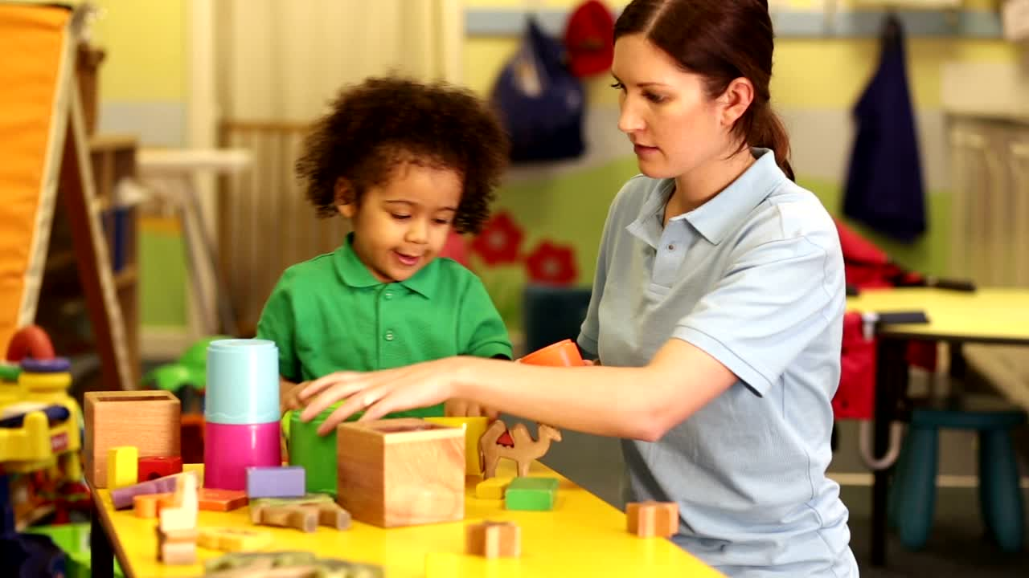
  Why This Matters
Children are born ready to communicate. Long before they learn to read...
Long before they learn to write...
They learn to:
  listen
  watch
  imitate
  gesture
  speak
  explain
  question
  reason
Every conversation strengthens the foundations for future success.
Oracy is not an "extra." It is the foundation upon which all learning is built.

Slide 7
  What is Oracy?
Oracy is the ability to:
🗣 Express ideas clearly 👂 Listen carefully
💭 Think aloud 🤝 Discuss and collaborate
❓ Ask questions 💡 Explain reasoning
❤️ Communicate confidently and respectfully
Oracy is about much more than talking. It is learning through talk.

Slide 8

  WHat Does the Research Say?
Research consistently shows that children with strong early language skills are more likely to:
  succeed in reading.
  achieve well across the curriculum
build
  positive relationships
  experience better long-term educational outcomes.
regulate
their
  emotions
  develop confidence

Slide 9
  Every Adult Is a Language Teacher
Children don't only learn language during carpet sessions.
They learn language when adults:
  greet them warmly
  eat alongside them
  play together
  solve problems
  comfort them
  share stories
  wonder together
Every interaction is an
opportunity to build communication

Slide 10
  The Language Gap
Children arrive in nursery with vastly different language experiences.
Some have enjoyed thousands of rich conversations.
Others have had far fewer opportunities.
High-quality Early Years provision helps narrow these differences by ensuring every child experiences:
✔ Rich conversation
✔ New vocabulary
✔ Storytelling
✔ Singing
✔ Shared thinking
✔ Meaningful play
Every child deserves to find their voice.

Slide 11
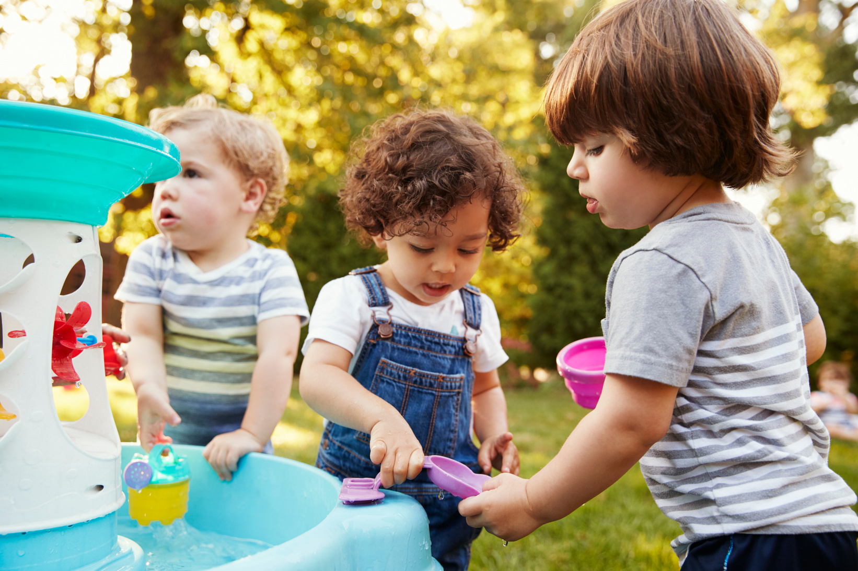
  Talk Before Tasks
Think about a typical activity.
Instead of moving quickly to the task...
Pause.
Talk first.
Wonder together.
Ask:
"What do you notice?"
"What do you think?"
"What might happen?"
Talk prepares the brain for learning.

Slide 12
  Oracy in Practice
Imagine children are building with blocks.
A practitioner might say:
"I can see you're balancing those carefully."
"What do you think will happen if you add another block?"
"I wonder why that one fell over."
"You've solved that problem differently this time."
The goal isn't simply conversation. The goal is to help children think through talk.

Slide 13
  Reflection Activity
Working with colleagues, observe one area of provision.
Consider:
  Who is doing most of the talking?
  Which children speak most?
  Which children rarely contribute?
  Where do meaningful conversations happen naturally?
  Which routines could become richer opportunities for talk?
Discuss one improvement your team could make immediately

Slide 14
  Reflection Activity
Choose one routine every day.
It could be:
🍎 Snack time 🧥 Getting dressed
🌳 Outdoor play 📖 Story time
🚶Walking to lunch
Slow down. Create one extra conversation.
Listen more than you speak. Notice how children's confidence grows.

Slide 15
  Reflection
Ask yourself:
Do I create opportunities for children to simply answer questions...
Or opportunities for them to express ideas?
Children develop confidence when they know their voice matters.
Children don't become confident communicators by chance.
They become confident because adults create environments where every voice is valued.
Every conversation says:
"You belong." "I'm listening." "Your ideas matter."
Today's conversations become tomorrow's readers, writers, thinkers and learners.

Slide 16

  Spark forward
This week, don't aim to ask more questions.
Aim to have more conversations.
Be curious. Listen carefully. Wonder together.
Because oracy isn't taught in one lesson.
It is built conversation by conversation, every single day.
Next week we'll explore Building Vocabulary Through Everyday Moments, discovering how ordinary routines can become extraordinary opportunities for language development.

Slide 17
  Research links
Education Endowment Foundation - Communication and Language Approaches
Education Endowment Foundation - Preparing for Literacy Guidance Report
Department for Education - EYFS Statutory Framework
Voice 21 - What is Oracy?
"Reading and writing float on a sea of talk." - James Britton

Slide 18
  The smallest conversations often have the biggest impact. Keep listening. Keep wondering. Keep sparking a love of learning.

