Slide 1


Working as Part of a High-Impact Teaching Team
Effective Communication with Class Teachers
Session 1

Slide 2


Safeguarding Spark
At the end of the day, a pupil quietly tells you:
“I don't like going to Dad's house anymore. His new girlfriend gets really angry and sometimes throws things.”
The parent is waiting outside the classroom.
Discuss:
What would you do next?
What would you avoid doing?
What information would be important to record?

Slide 3
Safeguarding Spark
The pupil has shared information that could indicate a safeguarding concern.
Remain calm and allow them to speak without investigating or asking leading questions. Record their words as accurately as possible, alongside the date, time and relevant context, and ensure the concern is shared promptly with the DSL in line with school procedures.
Importantly, do not raise the disclosure with the waiting parent yourself. The DSL needs to consider what action is appropriate and whether speaking to a parent could increase risk.
Key discussion: Your job is not to decide whether abuse has occurred.
Your job is to recognise that the information may be significant and make sure it reaches the right person.

Slide 4
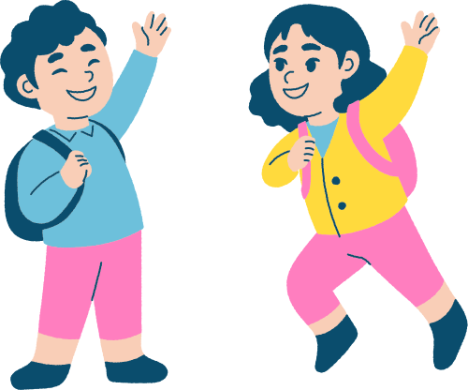
By the end of today's session you will:
✓ UNDERSTAND Explain why effective teacher–TA communication is essential to high-quality pupil support.
✓ RECOGNISE Distinguish useful communication from information that is vague, unnecessary or difficult to act upon.
✓ APPLY Use concise communication to share learning information, clarify expectations and raise concerns.
✓ REFLECT Consider how your communication contributes to a strong professional partnership.

Slide 5
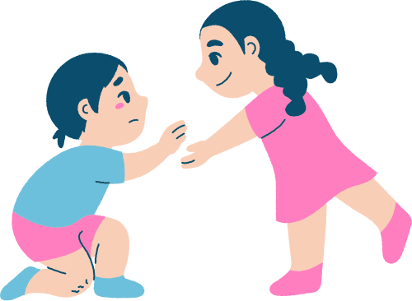
The Journey
⭐ Week 1 – Effective communication with class teachers
Week 2 – Understanding roles and shared responsibility for pupils
Week 3 – Sharing useful observations about learning
Week 4 – Planning and preparing together efficiently
Week 5 – Professional challenge and constructive conversations
Week 6 – Reflecting on teamwork and collective impact
This week: How can effective teacher–TA communication lead to better support for pupils without creating unnecessary workload?

Slide 6
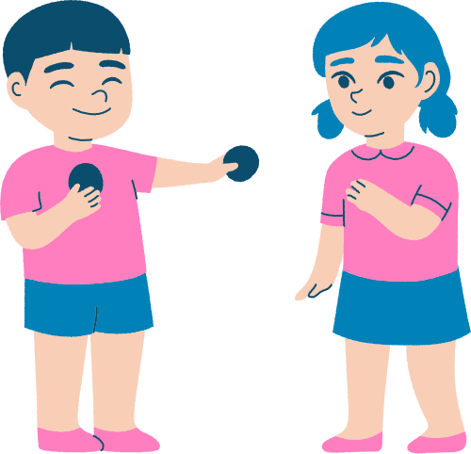
Why Communication Matters
A TA can have excellent relationships with pupils and strong classroom skills...
But without communication they may not know:
What pupils are learning
What the teacher expects
Which pupils need particular support
What should remain challenging
What happened before they arrived
What the teacher needs to know afterwards
Effective support depends on shared information.
TAs shouldn't have to guess what the teacher is thinking.

Slide 7
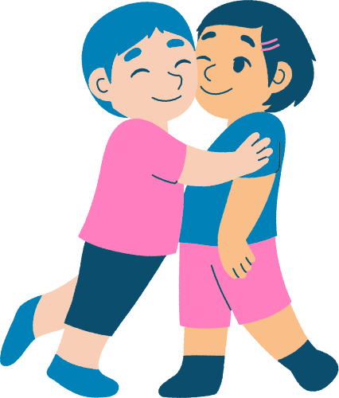
Communication Is More Than “What Am I Doing?”
A common teacher–TA conversation is:
“Who am I working with?”
That's useful. But effective communication goes further.
Ask:
WHAT? What are pupils learning?
WHY? What's most important about today's learning?
WHO? Who may need additional support?
HOW? How should I support them?
WATCH FOR? What should I notice and feed back?
Deployment tells us where to be. Communication tells us why we're there.

Slide 8
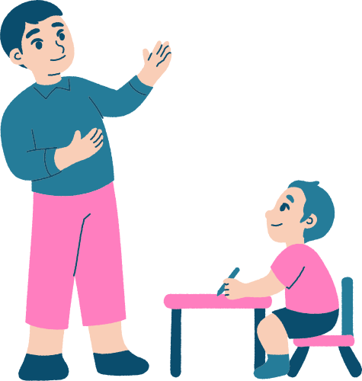
Before the Lesson: Get the Essentials
Teachers and TAs rarely have time for lengthy planning meetings before every lesson.
So focus communication on what matters most.
Before a lesson, a TA might need to know:
The learning intention Key vocabulary
Likely misconceptions Important adaptations
Which pupils need closer observation What type of support is appropriate
The aim isn't more paperwork.
It's the right information at the right time.

Slide 9
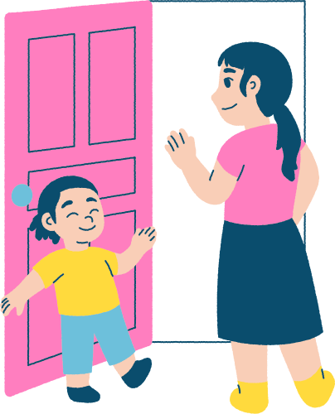
A 60-Second Briefing
Teacher–TA communication can be short and still be effective.
For example:
“Today we're comparing fractions.”
“Keep the language denominator and numerator consistent.”
“Watch Sam — yesterday he thought a larger denominator meant a larger fraction.”
“Use the fraction strips if needed, but let him choose first.”
In less than one minute, the TA knows:
Learning → Language → Barrier → Scaffold → Expectation
Brief doesn't have to mean vague.

Slide 10
During the Lesson: Communicate Without Disrupting
Not every message needs a conversation. During teaching, communication might include:
Eye contact A gesture
A quick note Pointing towards a pupil
A shared classroom routine A short check-in while pupils work
For example:
Teacher: “Can you watch whether that group can explain why their strategy works?”
Now the TA knows exactly what to notice.
Effective teams develop efficient ways to communicate while learning continues.

Slide 11
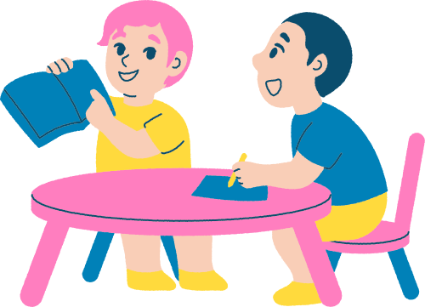
Share Observations, Not Labels
After supporting pupils, avoid vague statements such as:
❌ “They struggled.”
❌ “He didn't get it.”
❌ “She was brilliant.”
Instead share what you actually observed.
✓
“He could identify the numerator but confused the denominator.”
“She completed the calculation independently but couldn't explain her method.”
“He needed two prompts before starting but then worked independently.”
Specific observations are easier for teachers to act upon.

Slide 12
Share Observations, Not Labels
This is important across both learning and safeguarding.
FACT: “Ella answered the first three questions independently and then stopped working when the task changed.”
INTERPRETATION: “Ella gave up because she lacks confidence.”
The interpretation may be correct.
But it may not be.
Perhaps she misunderstood the instruction.
Perhaps the vocabulary changed.
Perhaps she was distracted.
Try: OBSERVE → DESCRIBE → DISCUSS
Rather than: ASSUME → LABEL

Slide 13
Tell the Teacher What Helped
Feedback shouldn't only identify what went wrong.
Tell the teacher what made a difference.
For example:
“Once he used the number line, he solved the next three independently.”
“Rehearsing the sentence aloud helped her write without further prompts.”
“When I pointed back to the success criteria, he corrected it himself.”
This helps answer:
What support can we use again — and what might we begin to reduce?

Slide 14
Ask When You're Unsure
There can be pressure on experienced TAs to feel they should automatically know what the teacher wants.
But professional communication includes asking.
Try:
“What do you want me to prioritise here?”
“Would you like me to prompt or allow more thinking time?”
“Which method are you teaching them to use?”
“What should I look out for?”
“Do you want me to feed anything specific back afterwards?”
Clarifying expectations is professional practice — not lack of expertise.

Slide 15
Avoid the Corridor Curriculum
Sometimes important information gets shared:
On the way to lunch Across the classroom
At the photocopier As pupils enter
Five seconds before the lesson Informal communication is inevitable.
But key information can easily be lost.
Ask: What information genuinely needs a reliable system?
Examples might include: Planning, Intervention information, Pupil adaptations
Assessment observations, Follow-up actions
Important information shouldn't rely entirely on chance conversations.

Slide 16
Communication Should Work Both Ways
Effective teamwork isn't:
Teacher tells → TA does
Teaching assistants often notice things teachers cannot see while teaching thirty pupils.
They may notice:
A misconception A successful strategy
A change in independence A pupil avoiding something
A resource that worked particularly well
So communication should be: TEACHER ↔ TA
Both contribute different information about pupil learning.

Slide 17
Know What Needs Immediate Communication
Not everything can wait until the end of the lesson.
Some information needs sharing quickly.
For example:
Safeguarding concerns A significant wellbeing issue
A serious behaviour incident A pupil becoming unsafe
Something that fundamentally changes the teacher's understanding of the situation
Other learning observations may be shared at a more appropriate time.
Ask: “Does someone need to know this now — or simply need to know it?”
Professional judgement includes choosing the right time and route.

Slide 18
Communication and Confidentiality
Being part of a team means sharing relevant information.
It does not mean discussing pupils freely.
Ask: Who actually needs this information? Why do they need it?
Am I sharing it in an appropriate place?
Avoid discussing sensitive pupil information:
❌ in corridors around other pupils
❌ with parents who don't need to know
❌ socially with colleagues
❌ through personal messaging accounts
Professional communication should be purposeful, proportionate and appropriate.

Slide 19
When You Disagree
Strong teams don't always agree. A TA may think:
"This pupil needs more support."
The teacher may think: "They need more independence."
Rather than simply continuing differently, discuss it.
Try:
“I've noticed…” “When we tried…, the pupil…”
“I wonder whether…” “Could we try… and see what happens?”
Focus the conversation on:
Evidence → Pupil → Learning Not: Person → Blame → Defensiveness

Slide 20
Build Communication Around Pupils, Not Personalities
Teacher–TA relationships matter. But effective teamwork shouldn't depend entirely on whether two adults naturally “click”.
Professional communication should be:
Clear Respectful Specific
Solution-focused Centred on pupil learning
Instead of: “You never tell me what's happening.”
Try: “Having the key vocabulary before maths would help me reinforce the same language. Could we find a quick way to share it?”
Describe the need. Suggest the solution. Keep the pupil at the centre.

Slide 21
The High-Impact Communication Loop
BEFORE
CLARIFY What are we learning? What should I know?
↓
DURING
NOTICE What is the pupil understanding? What support is helping?
↓
AFTER
SHARE What was secure? What remains uncertain?
↓
NEXT
ADAPT What should we repeat, change, reduce or remove?
CLARIFY → NOTICE → SHARE → ADAPT

Slide 22
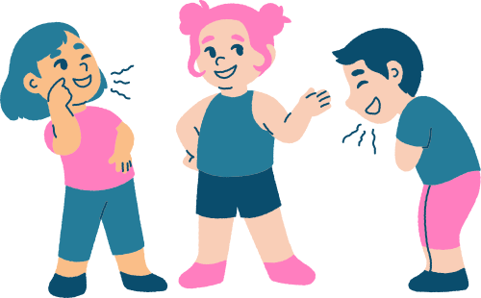
Reflection Activity
Before you leave...
1. Do I usually know the learning purpose before supporting pupils?
2. How specific is the information I give teachers about pupil learning?
3. Do I communicate what helped as well as what went wrong?
4. Is there one communication routine that would make teacher–TA teamwork more efficient?
Complete the sentence: “One change I will make to my communication this week is…”

Slide 23
Research Links
EEF – Making Best Use of Teaching Assistants
EEF – A School's Guide to Implementation
EEF – Special Educational Needs in Mainstream Schools
DfE – Keeping Children Safe in Education 2026

Slide 24
Great teacher–TA communication isn't about having more conversations. It's about making the conversations we already have more useful.
Clarify → Notice → Share → Adapt
When teachers and TAs share the right information at the right time, we reduce guesswork.
We strengthen support.
And most importantly:
Pupils experience one coherent teaching team - not two adults working alongside each other.
For the safeguarding Sparks going forward, I’d definitely keep this discussion-style format as one of several rotating approaches. It will make them feel much less formulaic while still keeping safeguarding at the forefront.

