Slide 1
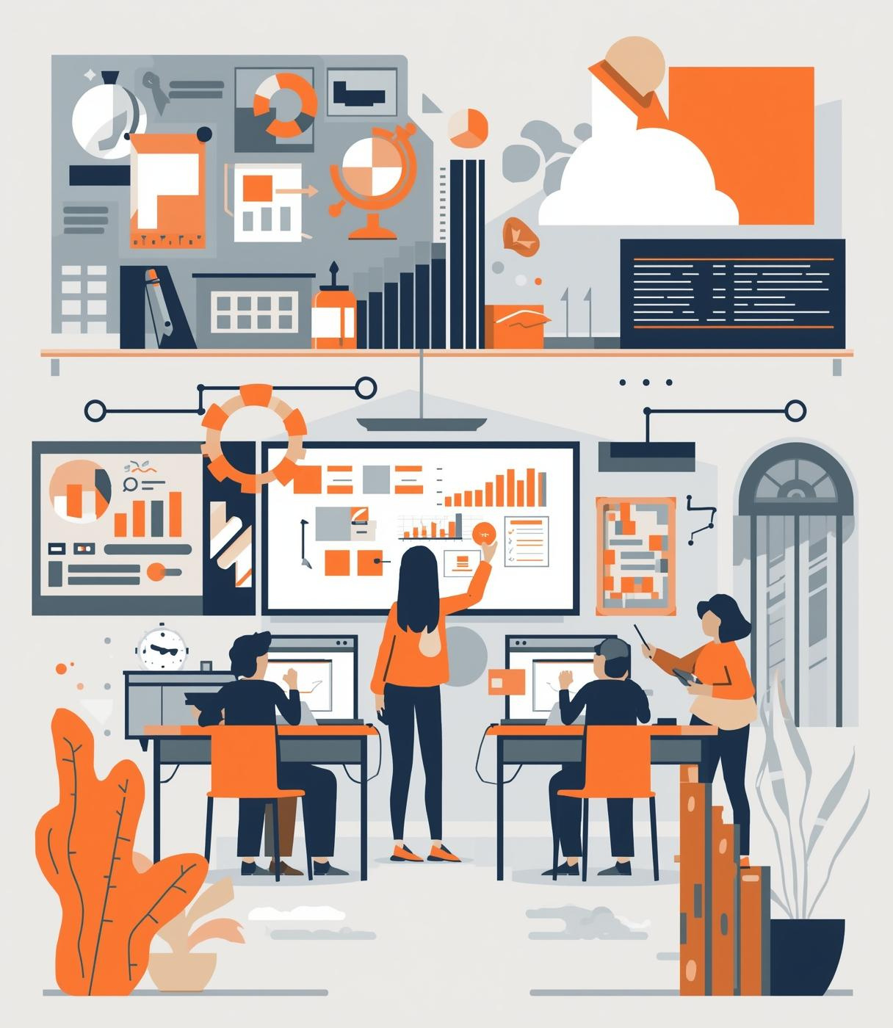

Classroom Climate & Relationships
BUILDING TRUST & RAPPORT WITH PUPILS

Slide 2

Safeguarding Spark
When should child protection records be shared?

Slide 3
Safeguarding Spark
Child protection records should be shared only on a strict need-to-know basis, meaning only with professionals who require the information to keep the child safe.
Wherever appropriate, consent should be sought from parents or carers; however, if seeking consent would place the child at further risk or delay action, information can be shared without consent under a statutory safeguarding duty.
Information must be relevant, accurate, and shared securely, following safeguarding policies and guidance such as those from HM Government.

Slide 4

Where This Fits
Session 1 – Building Trust & rapport
Session 2 – Establishing high expectations & consistency
Session 3 – Creating a positive classroom climate
Session 4 – Managing behaviour through relationships
Session 5 – De-escalation and relational responses
Session 6 – Sustaining a strong classroom culture

Slide 5
Why This Matters
👉 How pupils feel in your classroom
👉 How relationships shape behaviour and learning
Because relationships drive everything else.
Strong relationships lead to:
  Better behaviour
  Higher engagement
  Improved outcomes
  Greater wellbeing

Slide 6
Why This Matters
Research consistently shows that teacher–student relationships are a key driver of learning and engagement.
When pupils feel known and supported:
  They participate more
  They take risks
  They persist through challenge

Slide 7

Trust vs Rapport
Rapport = connection
Trust = belief in you
Both matter.
Rapport is about:
  Warmth
  Connection
  Approachability
Trust is deeper:
  Pupils believe you are fair
  Pupils believe you are competent
  Pupils believe you care
Research shows trust has a stronger impact on motivation than likeability alone.

Slide 8
What Builds Trust?
Consistency
Pupils trust adults who are predictable. When expectations and responses are consistent, pupils feel safe and secure.
Fairness
Perceived fairness is critical. Pupils notice how others are treated, and trust grows when they feel rules and consequences are applied equally.
Competence
Pupils must believe that their teacher knows what they are doing. Clear explanations, strong subject knowledge and structured lessons build confidence.
Care
Genuine care — knowing pupils, listening to them, and valuing them — is at the heart of trust. Research highlights care as a key component of positive relationships.

Slide 9
What Builds Rapport?
Rapport is built through:
  Positive interactions
  Listening
  Humour
  Showing interest
Rapport develops through small, everyday interactions:
  Greeting pupils
  Using names
  Showing interest in their lives
  Shared moments of humour
These create connection — but must sit alongside trust.

Slide 10
The Power of Small Moments
Trust is built in:
  Greetings
  Conversations
  Feedback
  Daily interactions
Trust is not built in big moments.
It is built through:
👉 Daily, consistent interactions
Research highlights that trust develops through repeated, positive experiences over time

Slide 11
High Expectations + Strong Relationships
The best classrooms have:
  Warmth
  Structure
  Challenge
Relationships should:
  Support behaviour
  Support learning
  Maintain high expectations
Relationships ≠ lowering expectations
Strong relationships = high expectations + support

Slide 12
Common Pitfalls
Avoid:
  Being “too soft”
  Inconsistency
  Favouritism
  Superficial relationships
Strong relationships are not:
  Just being liked
  Avoiding challenge
  Ignoring behaviour
They are built on:
👉 Respect + consistency + care

Slide 13
Reflection
Do pupils trust me?
Do they feel known?
How do I build relationships daily?
What do you do daily to build trust?
What could you strengthen?

Slide 14
Research
📌 Education Endowment Foundation – Improving Behaviour in Schools
Highlights the importance of strong relationships and consistent routines.
📌 Education Endowment Foundation – Metacognition & Self-Regulated Learning
Links classroom climate and trust to pupil independence and engagement.
📌 Ofsted – Education Inspection Framework
Emphasises a positive, respectful classroom culture.
📌 Teacher–Student Relationships Research (UK context)
Shows strong links between relationships, wellbeing and outcomes.

